Slide 1
Parenting for Peace
NM Boys At Risk Conference
May 2019

Slide 2
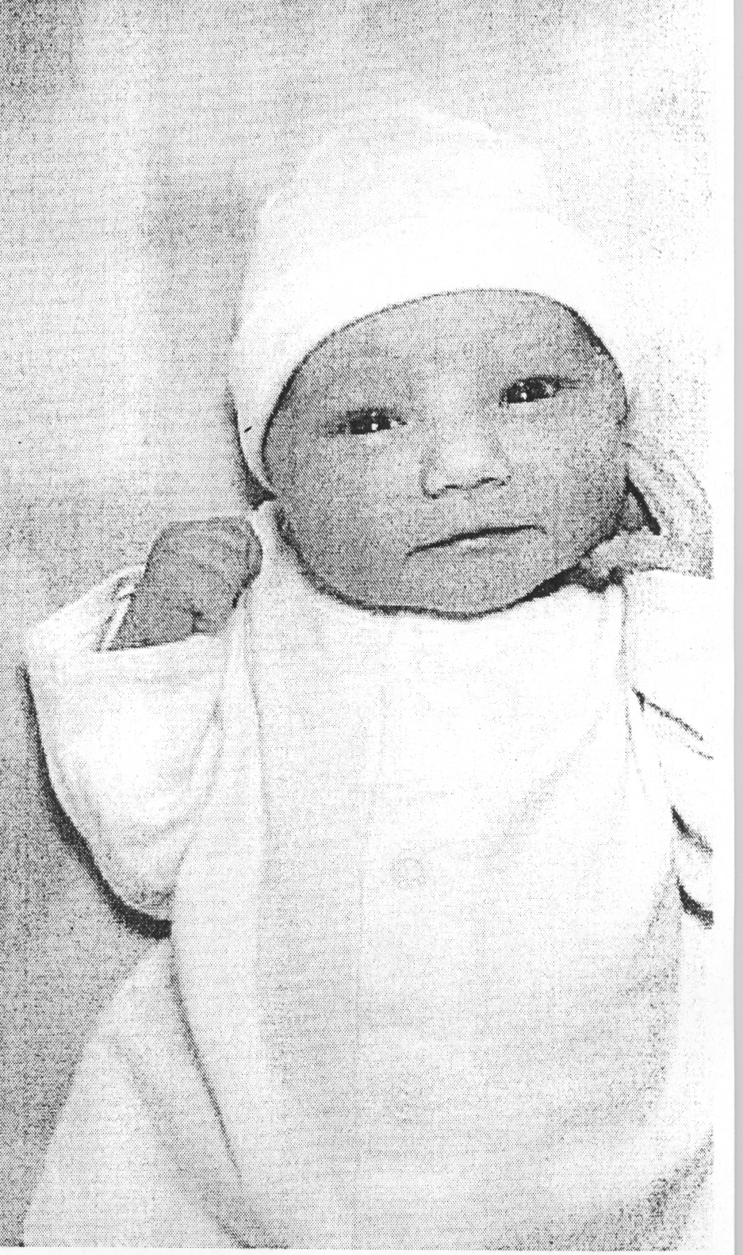

Slide 3
Be Part of the Solution!
Foster Emotional Fluency
Limit Screen Time & Exposure to Violent Media
Discipline without Corporal Punishment

Slide 4
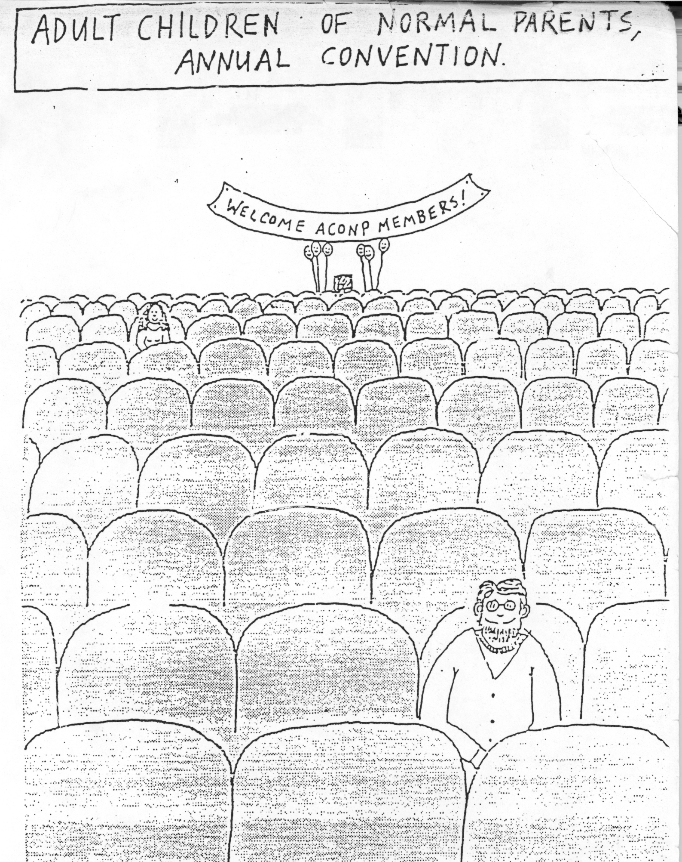

Slide 5
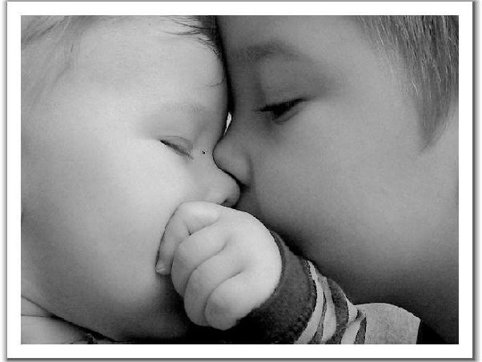
Babies gradually learn emotional intelligence

Slide 6
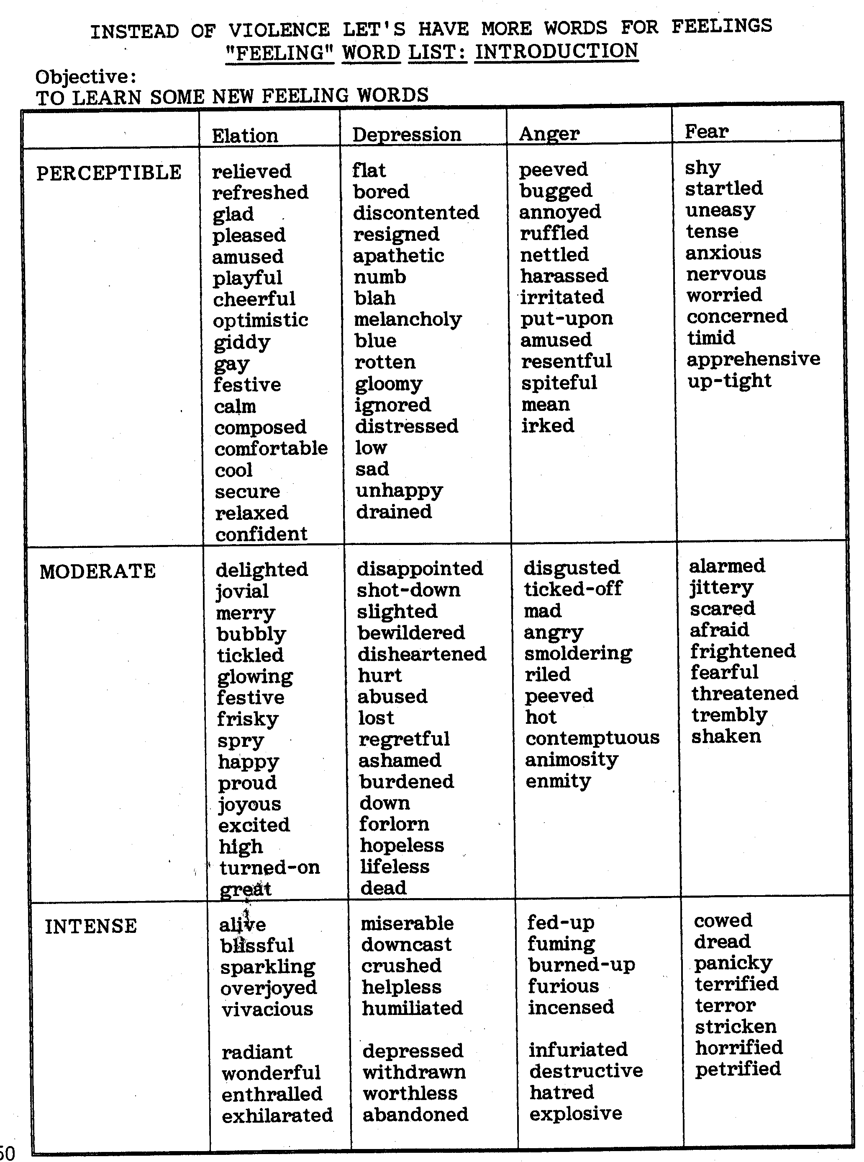

Slide 7
The language of Affection & Tenderness
Words spoken & written
Gifts given & received
Actions, acts of service, rituals
Focused and hang out time sharing interests
Affection, hugs, massages, facial expressions
Listening with considerate thoughtful attention
Food preparing and sharing

Slide 8
All Feelings are Okay
All Behaviors are not

Slide 9
AAP Policy Statement Media and Young Minds
For children younger than 18 months, discourage use of screen media other than video-chatting.

Slide 10
Evidence is sufficient to recommend time
limitations on digital media use for
children 2 to 5 years to no more
than 1 hour per day to allow children
ample time to engage in other activities
important to their health & development
and to establish media viewing habits
associated with lower risk of obesity later
in life.

Slide 11
For parents of children 18 to 24 months of age who want to introduce digital media,
advise that they choose high-quality programming/apps and use them together with children, because this is how toddlers learn best.
Letting children use media by themselves should be avoided.

Slide 12
Recommend no screens during meals and for 1 hour before bedtime, and remove devices from bedrooms before bed.
Help families develop a Family Media Use Plan www.healthychildren.org/MediaUsePlan with specific guidelines for each child and parent.

Slide 13
Violence is any mean word, look, sign, or act that hurts a person’s body, feelings, or things.

Slide 14
* Small group in large open space, or large group in confined space will result in more aggressive behaviors.
* When a child is acting aggressively, offer positive consequences for alternative behaviors. Give attention for positive behaviors. If aggression tends to occur in similar situations, offer the extra attention ahead of time. When aggression is occurring, focus attention on the victim: "no one is allowed to hurt you for any reason; you can tell him to stop kicking." Or direct the aggressor to assist the injured child.
* If both parties are being aggressive, separate the children and calmly state: "there is no hitting in our school. Hitting hurts. When you are ready to talk calmly, I'll help you work it out."

Slide 15
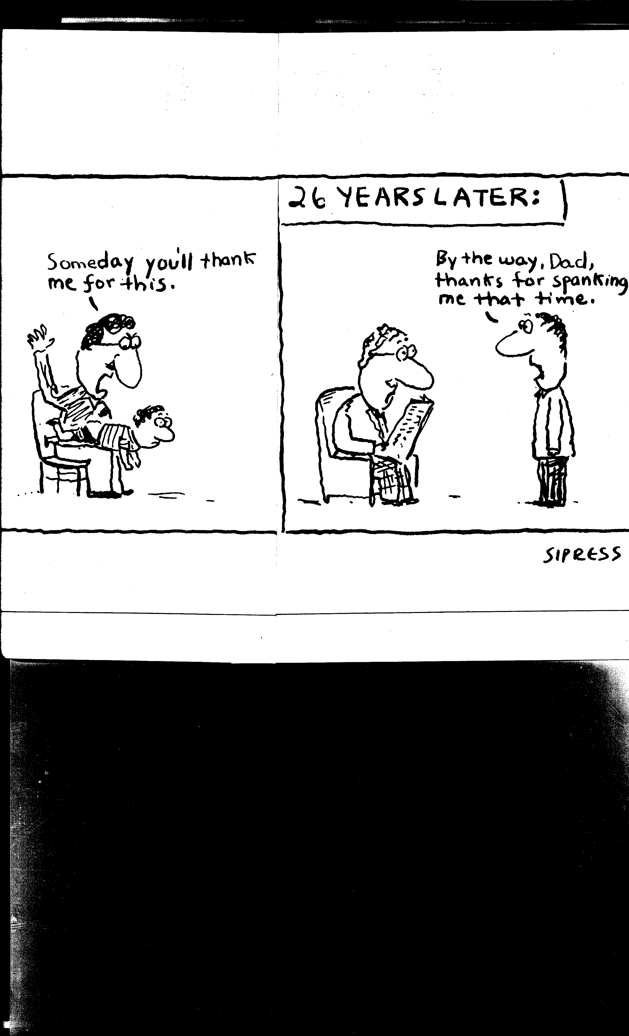

Slide 16
Discipline is teaching. | Spanking is punishment.
Teaches self control. | Teaches fear.
Teaches your child that hitting is not okay; it hurts. | Shows her that hitting is okay, if you are the biggest and strongest.
Teaches your child how to be good. | Shows your child that she is bad.
Teaches your child to keep the rules out of respect for herself and others. | Teaches her to keep the rules so you will not hit her.

Slide 17
Discipline is teaching | Spanking is punishment.
Shows your child she is a good person who learns from mistakes and practice. | Shows her she is bad, you don’t respect her, she doesn’t learn well, & deserves to be hurt.
Teaches your child to think for herself and do the right thing. | Teaches her to do what keeps her from getting hit.
Leaves you and your child feeling okay about yourselves and each other. | Leaves your child in pain, feeling bad about herself and you.

Slide 18
What to do when witnessing someone being abusive in a public place:
Approach in a calm non-judgmental manner.
Blend with the difficulty the caregiver is experiencing.
Create the possibility of change.
Do something helpful, or make the offer.
Engage the child with positive attention.

Slide 19
Focus on the child’s own pleasure at achieving
Help him/her to self-evaluate.
Ask about their inner experiences.
Use I statements and express your appreciation in terms of your own feelings.
Comment on the behavior not the person.

Slide 20
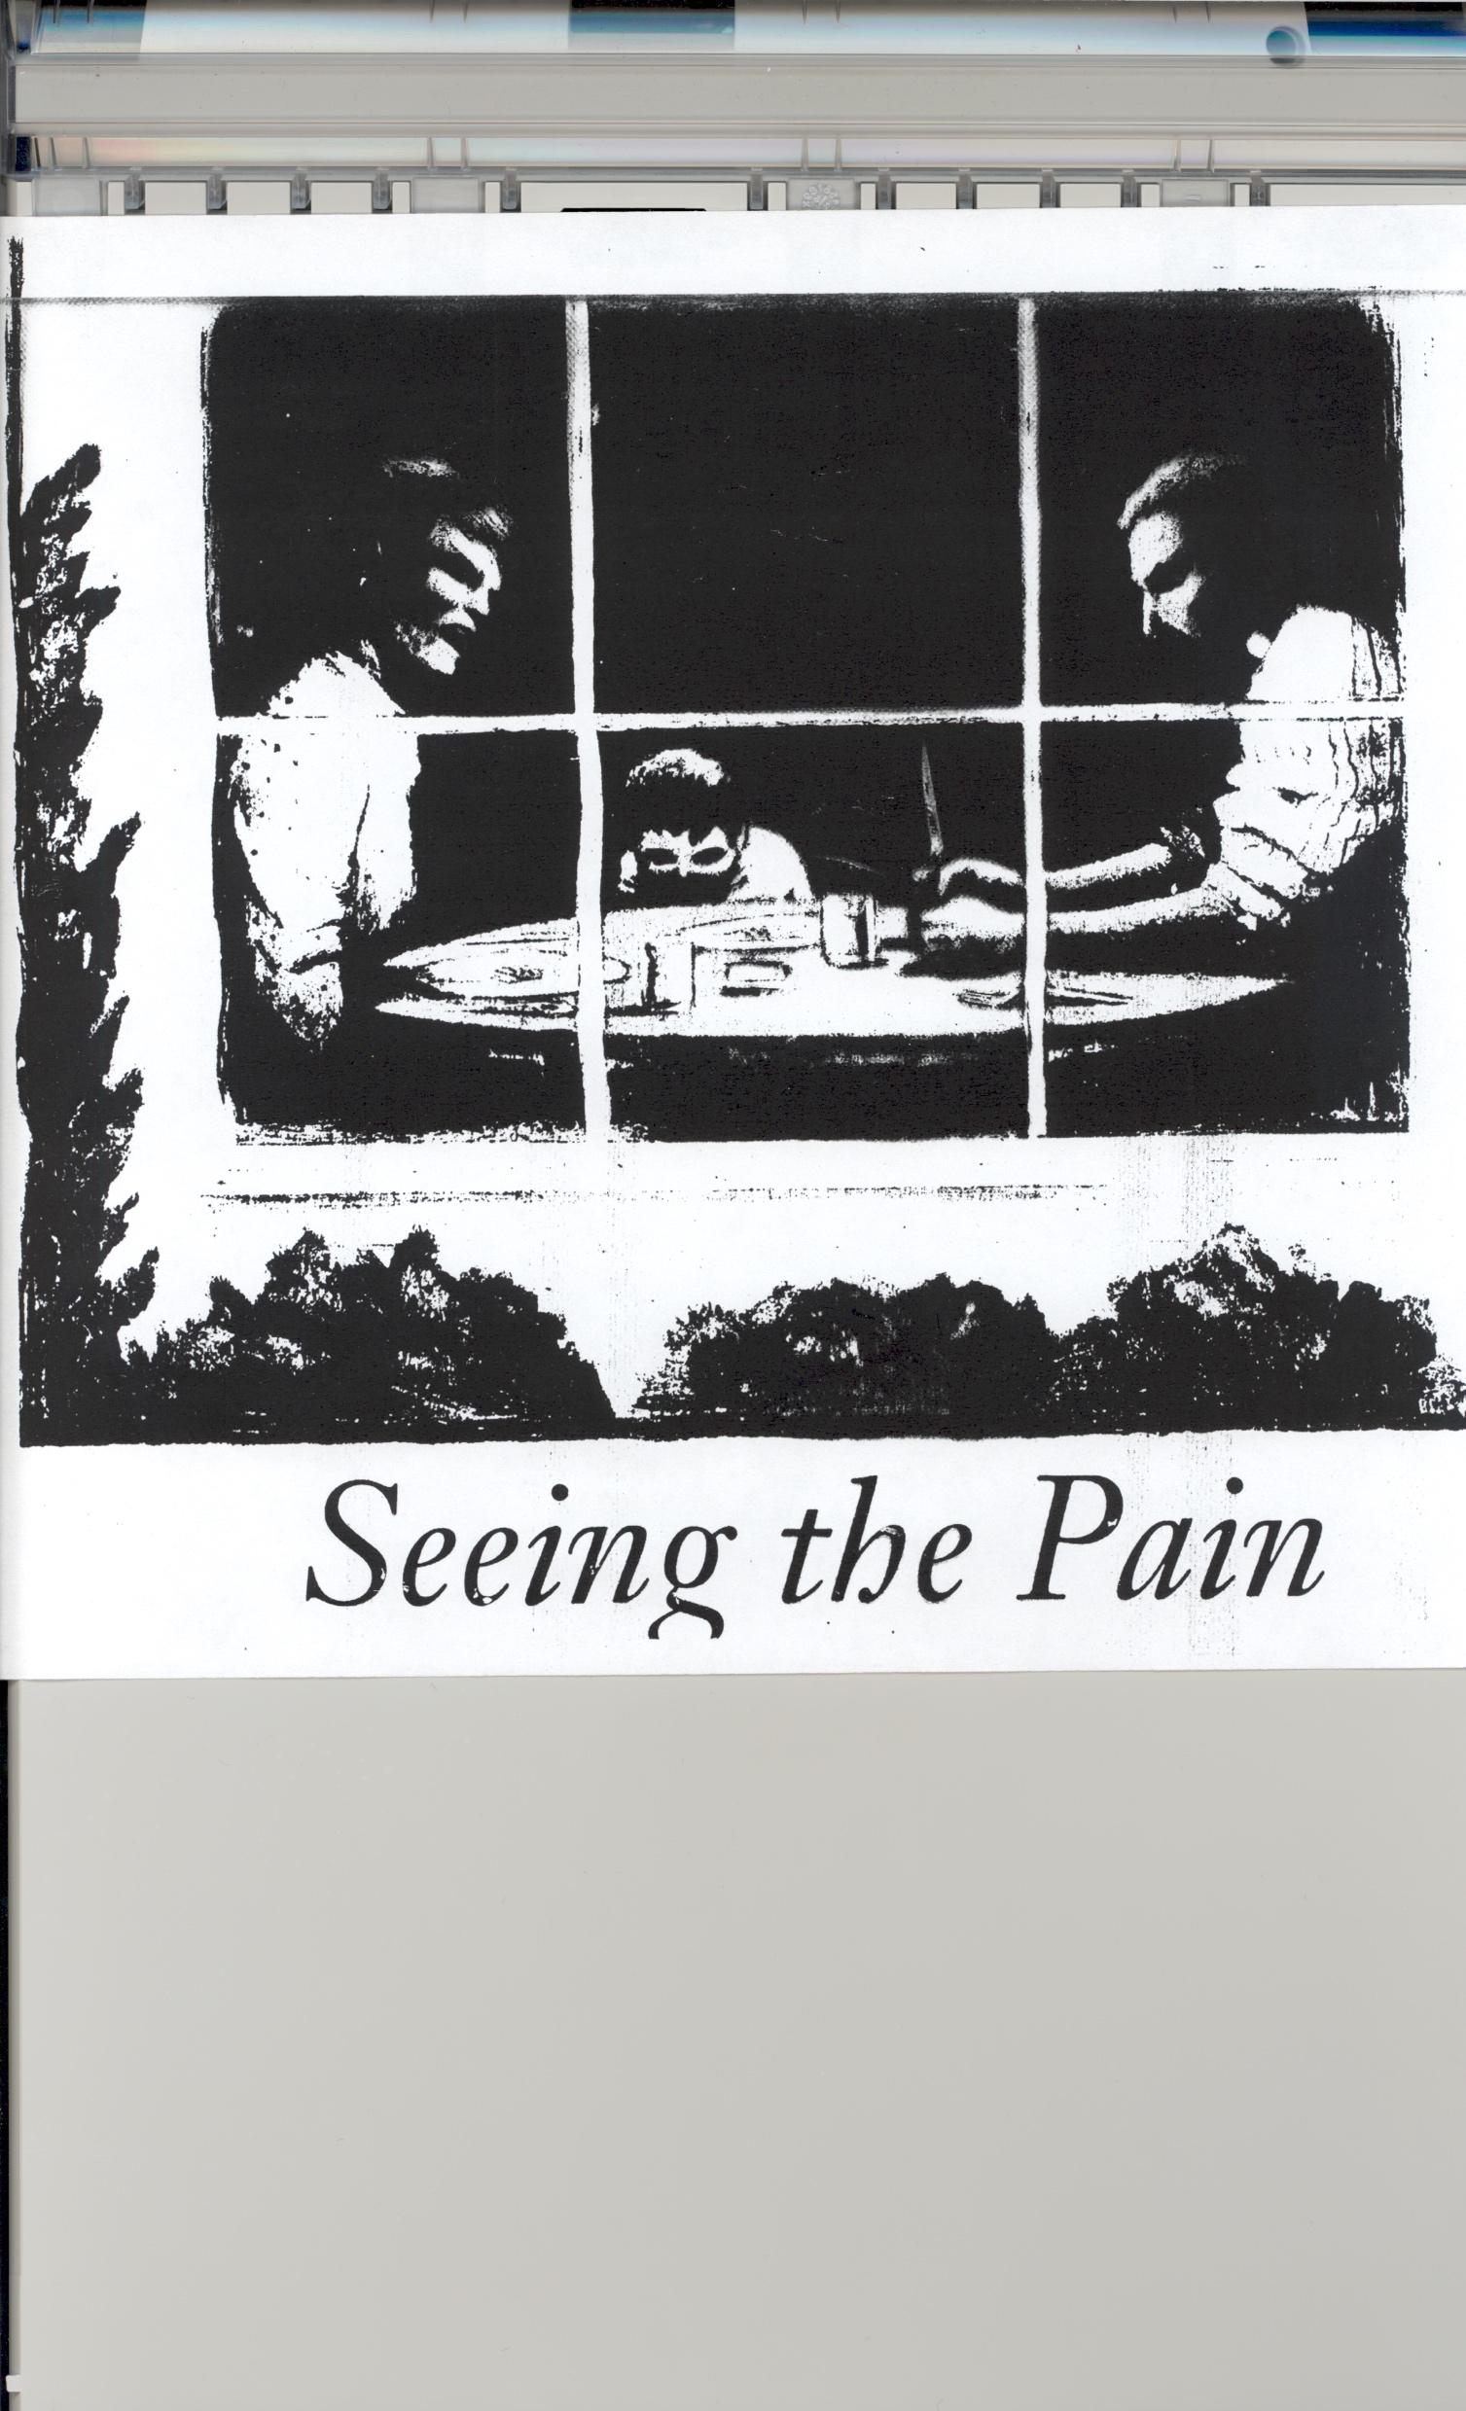

Slide 21
The more violence that youths had been exposed to, the more likely they were to:
Be violent themselves
Misuse drugs and alcohol
Be labeled as conduct disorder
Be suicidal
Be depressed

Slide 22
How does abuse engender violence?
Parental violence is modeled.
Abused children expect hostility and are hypervigilant to potentially hostile cues, reacting aggressively to mildly provocative social situations.
Abuse often results in neurologic damage which increases impulsivity and decreases judgment and foresight.
The stress of abuse alters brain physiology, changing neurotransmitter and hormone levels.
Abuse engenders rage, which is often displaced from the parents onto teachers and peers.

Slide 23
SIGNIFICANT SEVEN:
I AM CAPABLE.
I AM NEEDED AND CONTRIBUTE IN MEANINGFUL WAYS.
I CAN INFLUENCE WHAT HAPPENS TO ME.
STRONG INTRA-PERSONAL SKILLS.
STRONG INTER-PERSONAL SKILLS.
SENSE OF RESPONSIBILITY.
SENSE OF JUDGMENT.

Slide 24
