Slide 1
Boys and Violence: A Developmental Systems Perspective on Early Origins
Hiram E. Fitzgerald, PhD
Department of Psychology
Michigan State University
Conference on Early Origins of Male Violence
Santa Fe, NM
May 1-3, 2019

Slide 2
Some USA Data: Table 42: Arrests for Violent Offences by Sex in the United States, 2015. Source: United States Department of Justice. (2016a).
Offense Charged | Number of Persons Arrested |  |  | Percent
 | Total | Male | Female | Male | Female
Murder and nonnegligent manslaughter | 8,533 | 7,549 | 984 | 88.5 | 11.5
Rape | 17,504 | 16,990 | 514 | 97.1 | 2.9
Robbery | 73,230 | 62,721 | 10,509 | 85.6 | 14
Aggravated assault | 288,815 | 221,993 | 66,822 | 76.9 | 23
Total | 388,082 | 309,253 | 78,829 | 77 | 23
Golding, P., & Fitzgerald, H. E. (2019)..

Slide 3
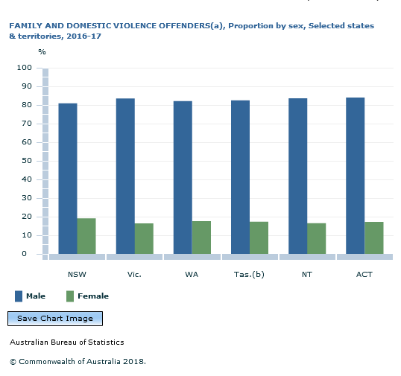

Slide 4
Risk – Resilience Continuum: A Developmental Systems Perspective

Slide 5
Developmental Systems Theory Principles
Probabilistic epigenesis
Developmental plasticity
Reciprocity of genes and environments
Nesting of environments (systems)
Centrality of time and timing in development
Problems of reductionism and tendency to study single components of a system in isolation
Role of novelty in development
Use of person-centered designs
The contextually bound nature of development
Equi-finality and multi-finality
Continuities and discontinuies

Slide 6
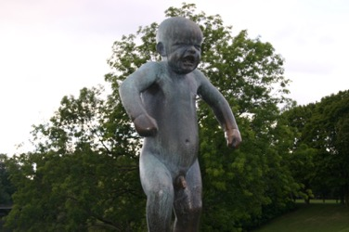
Origins of Risk Cumulating Influences and Heterogeneity of Developmental Pathways of Risk
Photo: Gustav Vigeland Sculpture Park, Oslo Norway 2009

Slide 7
Greater Incidence for Boys
Mortality | Morbidity
Diarrhoeal diseases | Rickets
Measles | Meningitis
Dyptheria | Septicaemia
Tuberculosis | Enterovirus
Pneumonia | Acute lower respiratory disease
Syphilis | Malnutrition
Respiratory disease syndrome | Autism
Haemorrhages | Attention Deficit Hyperactivity Disorder
Sudden Infant Death Syndrome | Attention Deficit Disorder
Infectious disease | Dyslexia
Chronic lung disease | High activity levels
Immunizations | Higher irritability
Accidents | Self-regulatory problems

Slide 8
Sex/Gender Differences in Psychopathology: Analysis of published studies in Journal of Abnormal Psychology and Journal of Abnormal Child Psychology from 2010-2017 (total of 1605 studies). (Adapted from Hartung & Lefler, 2019)
Antisocial personality disorder | M > F
Conduct disorder | M > F
Paranoid personality disorder | M > F
Schizoid personality disorder | M > F
Voyeuristic disorder | M > F
Exhibitionistic disorder | M > F
Sexual masochism disorder | M > F
Sexual sadism disorder | M > F
Pedophilic disorder | M > F
Fetishistic disorder | M > F
Cannabis Use Disorder | M > F
Pyromania | M > F
Intellectual disability | M > F
Attention deficit hyperactivity disorder | 2-3M:1F
Obsessive compulsive disorder | 4M:1F
Oppositional defiant disorders | 1.4M:1F child M=F adult
Alcohol use disorders | 2.5M: 1F
Phencyclidine Use Disorder | 2M:1F
Specific learning disorder: reading | 2-3M:1F
Autism spectrum disorders | 4M:1F

Slide 9
Epigenetics: Altering Gene Expression through Experience
Prenatal Epigenetic Changes | Postnatal Epigenetic Changes
Poor nutrition | Environmental adversity
Maternal depression | Child maltreatment
Stress | Abuse
PTSD | Stress
Smoking | Parenting
Prematurity | Psychopathology
Neurodevelopmental disorders | Behavioral disorders
Lester,., Conradt, & Marsit, (2016).
Example: Prenatal maternal stress---predicts methylation of genes regulating the mothers and infant’s HPA stress regulatory systems.
Kertes,., Kamin, , Hughes,, Rodney,, Bhatt,, & Mallieun,. (2016)

Slide 10
Genetic mutation rates:
5 times higher on X compared to Y.
95% of Y does not exchange DNA with X,
Therefore:
Genetic mutations are more likely to express if paired with a Y, because no gene copy on Y
Eme, R. E. (2007).

Slide 11
Prenatal: Maternal Smoking
Birth Cohort: 4000 males.
Contributes to prefrontal and amygdala impairments.
Dosage Effect: More smoking, the more violence in males.
Maternal smoking plus: single parent status. Recidivistic violence 11.9 OR.
Maternal smoking plus: single parent status
teenage pregnancy
unwanted pregnancy
developmental motor lags
Each of the above variables influences epigenetic change, so it is the systemic effect of all of these factors—(adverse childhood experiences).
Rasanen, et al. (1999).
RV increases to 14.2 OR

Slide 12
Prenatal Influences on Male Future Violence:
Nutritional Deficiency: 100,000 men:
Less Omega-3 (from fish): critical for brain structure and function:
26 countries: low fish consumption—higher homicide rates (males)
2.5 times more likely for ASPD in adulthood
Boys: more likely to be aggressive, puberty through end of teens.
Liu, et al. (2004).
Drinking:
Paternal effects: altered gene expression via epigenetic effects on sperm.
Maternal effects: teratogenic role in brain areas and delay in maturation of frontal white matter tracts
Dai, et al. (2016).
Prenatal maternal stress---
predicts methylation of genes regulating the mothers and infant’s HPA stress regulatory systems.
Kertes,., Kamin, , Hughes,, Rodney,, Bhatt,, & Mallieun,. (2016)

Slide 13
Telomeres: Nucleoprotein Material on ends of Chromosomes
Shortened Telomeres in Adults
dementia,
osteoporosis,
diabetes,
stroke,
cardiovascular disease,
alcoholism,
stress
Telomere Shortening in Boys: Prenatal to Early Childhood
Higher number of childhood adverse experiences
Stress Exposure: Prenatal Exposure to Maternal Anxiety
Amount of Early Poor Institutional Care
Living in Disadvantaged Neighborhoods
Exposure to violence
Entringer, Epel,. ……Wadhwa, P.D. (2011); Drury, Theall,.,…..Nelson, (2012). Mitchell, Hobcraft, McLanahan,, Siegel, Berg,Brooks-Gunn…..Notterman,. (2014). Tyrka e al., 2010) , Shalev et al., 2012).

Slide 14
Michigan Longitudinal Study (MLS): Family risk for alcoholism and co-active psychopathology (1987 – 2018)
Population based community recruitment strategy
466 families:
N = ~ 2600 individuals (data on mothers, fathers, all children)
Recruitment: Based solely on father characteristics
At least one 3-5 year old son
Biological parents, residential (in beginning)
After recruitment: Three groups emerged with respect to father characteristics
High risk families: Alcoholic fathers & High antisocial behavior
Medium risk families: Alcoholic father
Low risk families: No alcoholic father

Slide 15
MLS: Preschool age Male COAs
High levels of hyperactivity
High negative mood and difficulty temperament
High levels of problematic social relationships
High levels of cognitive deficits
High levels of aggression
Precocious cognitive schemas about alcohol and drugs
Fitzgerald, Sullivan, Zucker, Bruckel, Schneider, & Noll, (1993)
Zucker, Kincaid, Fitzgerald, & Bingham, (1995).

Slide 16
MLS: High Risk Preschool Boys (3-5 yrs) as Adolescents (12-14 yrs) : Early drinkers
Weaker family structure (cohesion and organization
More negative self-evaluations (school, conduct/morality, global self-worth
Weaker family orientations (intellectual-cultural and moral-religious
More family conflict
More internalizing and externalizing behavior problems
More antisocial behavior
More association with delinquent peers and peers with juvenile justice contact
Less association with peers involved in conventional activities
Mayzer, R., Fitzgerald, H. E. & Zucker, R. A. (2009).

Slide 17
MLS: Characteristics of 18-20 yr old sons from high risk families
Self regulatory dysfunction
Difficult temperament
Attachment relationships problems
Activation relationship problems
Internalizing behavior problems
Externalizing behavior problems
Parent-child relationship disturbances
Poor value structure
Cognitive deficiencies
High risk peer network
Alcohol and other drugs
Involvement with criminal justice system
Set points for organization of psychopathology
Puttler, Zucker, & Fitzgerald. (2018).

Slide 18
Monoamine Oxidase A Gene (MAOA): Males are Hemizygous for high or low variant MAOA:
Low Varient MAOA: associated with behavior disorders, aggression, violence in boys.
Zucker, Hicks, & Heitzeg, (2016).
Puberty moderated the relationship between 5-HT (MAOA) and both behavioral disinhibition and negative affect in pubescent boys, but not in prepubescent boys.
Twitchell, Hanna, Cook, Fitzgerald, & Zucker, (2000

Slide 19
Comorbid Class: Inattention/Hyperactivity (n = 82)
Age
Comorbid Class: Aggression (n = 82)
Age
Jester, Nigg, Adams, Fitzgerald, Puttler,Wong, & Zucker, (2005).

Slide 20
Healthy Class: Inattention/Hyperactivity (n = 131)
Age
Healthy Class: Aggression (n = 131)
Age
Jester, J. M., Nigg, J. T., Adams, K., Fitzgerald, H. E., Puttler, L. I., Wong, M. M., & Zucker, R. A. (2005). Inattention/hyperactivity and aggression from early childhood to adolescence: Heterogeneity of trajectories and differential influence of family environment characteristics. Development and Psychopathology, 17, 1-27.

Slide 21
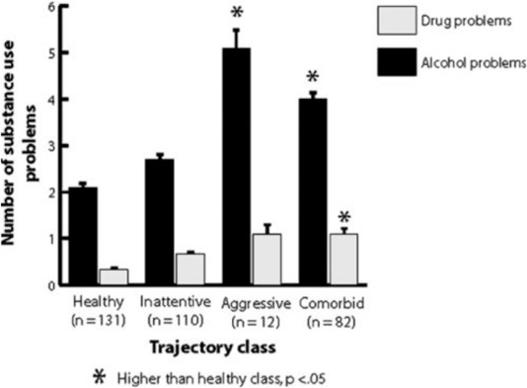
Average Number of Alcohol and Drug Problems for Each of Four Trajectory Class Groups (Bars indicate SEM)
Jester, Nigg, Buu, A., Puttler, Glass, Heitzeg, Fitzgerald, & Zucker, (2008).

Slide 22
Trajectories of Alcoholism Symptoms from ages 15 to 45
Four Pathways Identified
Early Onset Severe Men
Developmentally Limited Men Women
Young Adult Onset Men Women
Cumulative Men Women
Jester, J. M., Buu, A., & Zucker, R. A. (2016).

Slide 23
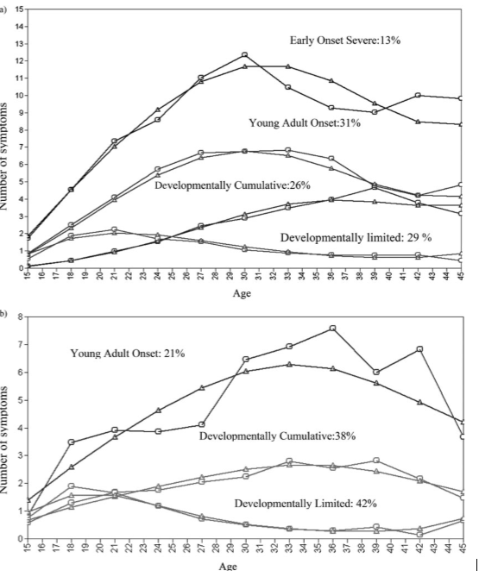
Males
(a) Trajectories of development of alcoholism symptomatology over age 15 to 45, for men. The smooth lines marked by triangles are the predicted trajectories from the model, and the lines marked by circles are the actual number of symptoms at each time point for the group.
Females
(b) Trajectories of development of alcoholism symptomatology over age 15 to 45, for women. The smooth lines marked by triangles are the predicted trajectories from the model, and the lines marked by circles are the actual number of symptoms at each time point for the group. YAO, Young adult onset; CUML, developmentally cumulative; DL, developmentally limited.
Jester, J. M., Buu, A., & Zucker, R. A. (2016).

Slide 24
Michigan Longitudinal Study: Predictors of pathology in Early Onset Severe Class (no females were in the EOS class).
Family density of alcoholism | higher
Child history of severe abuse | higher
Childhood antisocial behavior | higher
Education at baseline |  | lower
Occupation at baseline |  | lower
Depression (Hamilton) at baseline | higher
Depression worst in lifetime (at baseline) | higher
Beck depression current | higher
Suicidality at baseline | higher
Adult antisocial behavior | higher
Smoking: cumulative amount | higher
Age of first drink |  | younger
Age of 1st symptom |  | younger
Age of first diagnosis |  | younger
Progression to first symptom | faster
Jester, Buu, & Zucker, (2016).

Slide 25
Social Costs of the High Continuity Trajectory
Academic difficulty and failure
Date rape/sexual assault
Other kinds of physical injury to self and others (e.g. automobile accidents)
Impaired social relationships
Loss of social capital; foreclosure of future opportunities, higher poverty risk
Zucker et al. 2004

Slide 26
CONTINUUM OF ADVERSITY
ACES: Many biopsychosocial factors that additively predict poor developmental outcomes
TRAUMA: Extreme frightening, harmful, or threatening event that has intense impact with long term effects.
TOXIC STRESS: Chronic exposure to ACES or Traumatic Events without supportive caregiving

Slide 27
Transitional Periods over the Life Course: Relationship impacts and Program Exemplars
Transitional Influences
Work experiences
Partner selection
Education
Economic Independence
Family responsibilities
Success in Adulthood
Late Adolescence Transition Period (18-25)
Antisocial behavior
Depression
Unstable work experiences
Partner selection
Higher education
Internship programs
Work force training
Partner selection
Creative enterprises
Success in High School
Transitional Influences
Early Adolescence Transition Period (10-14)
Ongoing Life Course Risk Influences (Racial and Social Inequalities)
Quality afterschool programs
Effective mentoring programs
Safe environments
Parent monitoring
Youth entrepreneurial programs
Good school experiences
Poor peer group values
Poor school experiences
Violent neighborhoods
Behavior problems
Ongoing Life Course Resilience Influences
Transitional Influences
Success in Elementary School
Early Childhood Transition Period (0-5)
Strong Family Support
Quality afterschool activities
Quality child care/development
Positive Father involvement
Healthy nutrition
Positive parental relationships
Parental conflict
Maternal stress/depression
Paternal Alcoholism
Paternal antisocial behavior
Poor family resources
Success in Early Childhood
Epigenetic processes
Heritable characteristics
Epigenetic processes
Heritable characteristics
Prenatal
RISK
RESILIENCE
Notes:
Change chart – arrows; racial/social line; replace distal with lifecourse, find word for proximal

Slide 28
Systemic Sources of Risk Development
Through Family Characteristics
Children of alcoholics and other drug-using parents
Children of parents with antisocial personality disorder
Children of parents with clinical depression
Children of parents in conflict
Children of parents with low family resources
Children with poor prenatal & perinatal histories
Through Individual Characteristics
Externalizing behavior, aggression, behavioral undercontrol, oppositional defiant disorder
Negative emotionality, depression
Attention problems, ADHD
Shyness, social withdrawal, social phobias
Biological diathesis (genetic, congenital, perinatal)
Through Social Environments
High drug use environments
High stress environments (violence, poverty, unemployment)
Chronic exposure to toxic risk

Slide 29
Critical Development Transitions
Prenatal through Early Childhood (0 to 5 years)
Rapid physical, cognitive and socio-emotional development
Neurobiological, behavioral, mental networks organization
Foundation established for transition from home to school
Middle Childhood/Early Adolescence (10 to 15 years)
Rapid neurobiological/biological and psychological changes
More autonomy and skill development but increased exposure to risk
Sets trajectory for success in high school
Late Adolescence/Early Adulthood (18 to 25 years)
Transition from home and school to post-secondary education, employment, and self-sufficiency
Must acquire skills and attitudes to be successful in rapidly changing workplace

Slide 30
Prevalence of Specific Reported Adverse Childhood Experiences (ACEs), Total and Age (adapted from Sachs, Murphy & Moore, 2014)
Adverse Childhood Experiences | National Percentage of Children
Child ages: | All | 0-5 | 6-11 | 12-17
Low income | 26 | 25 | 26 | 26
Separation/Divorce | 20 | 10 | 22 | 28
Family Alcohol/Drug Problems | 11 | 6 | 12 | 15
Family Mental Illness | 9 | 6 | 8 | 11
Witness Neighborhood Violence | 9 | 3 | 8 | 14
Witness Domestic Violence | 7 | 4 | 8 | 10
Parent Incarcerated Sometime | 7 | 5 | 8 | 8
Parent Death | 3 | 1 | 3 | 5
Percent of children nationally with 0 (54%), 1-2 (35%) or 3+ (11%) adverse experiences (aged birth to 17).
74.2 Million children: .11 x 74.2 = 8,162,000 children with 3 or more ACES

Slide 31
Australian Temperament Project: Recruited at 4-8 months old.
Risk at 27-28 years: 4 or more ACES | OR
Formally charged by police | 6.1
Non-driving offense | 4.0
Driving offense | 1.5
Have baby before age 22 | 10.2
Chronic health problems | 1.8
Physical health problems | 2.9
Mental health problems | 2.3
Drank alcohol 5+ times weekly | 1.7
Binge drinking | 0.8
Daily smoking | 2.6
Marijuana use | 1.9
ASB score highest level | 2.9
High school dropout | 2.5
Main income: Government | 2.8
ACES Studied
Emotional abuse
Physical abuse
Sexual abuse
Neglect
Parental separation
Domestic separaton
Household mental illness
Household Substance abuse

Slide 32
Implications for Infant Mental Health Theory, Research, and Practice

Slide 33
Types of Prevention Based on Risk
Universal – Directed to entire population
Selected Interventions - Directed to targeted at-risk subpopulation
Indicated interventions – Directed to high-risk symptomatic populations
Non system change driven: Typically produce low effect sizes, high attrition
August & Gewirtz (2019).

Slide 34
Infant/early childhood effective home visiting models: Yes = outcomes with infant mental health impacts
Program | Child Health | Maternal Health | Child Development | < Child Maltreatment
Attachment and Biobehavorial Catch-Up (ABD) | Yes |  | Yes
Child First |  | Yes | Yes | Yes
Early Intervention Program (teen mothers) | Yes
Early Head Start Home Visiting |  |  | Yes | Yes
Early Start (New Zealand) | Yes |  | Yes | Yes
Family Check-up |  | Yes | Yes
Family Connects | Yes | Yes
Family Spirit |  | Yes | Yes
Health Access Nurturing Developmental Services | Yes | Yes
Healthy Beginnings | Yes | Yes | Yes
Healthy Families America | Yes | Yes | Yes | Yes
Home Instruction for Parents of Preschool Youngsters |  |  | Yes
Maternal Early Childhood Sustained HV Program | Yes | Yes
Minding the Baby | Yes | Yes
Nurse Family Partnership | Yes | Yes | Yes | Yes
Parents as Teachers |  |  | Yes | Yes
Play and Learning Strategies Infant |  |  | Yes | Yes
Self Care Augmented |  |  |  | Yes
Fitzgerald & McGreal, in press

Slide 35
Recommended Person-based (Precision) Interventions:
Identification of moderators: personality-based risk factors (e.g., impulsivity, depression, anxiety, sensation seeking)
Adaptive-sequential intervention designs (change over time based on individual’s responses)
Active engagement of participants in decision making about services received.
Use of personalized devices for accessibility and real-time assessment (smartphones, wearable GPS units, data capture tools)
August & Gewirtz (2019).

Slide 36
Some Data on U.S. Dads (all estimates from census statistics, 2013
Number of fathers in the USA: 70.1 million
Fathers with Children less than 18 years of age:
Number of fathers in married-couple families: 24.7 million
Number of single father households: 2.7 million (2.5 million more than 1960) ; Most likely: younger, minority, less educated, poorer.
Stay at home dads: 214,000
Number of preschoolers cared for by dads during mom’s working hours: 18%

Slide 37
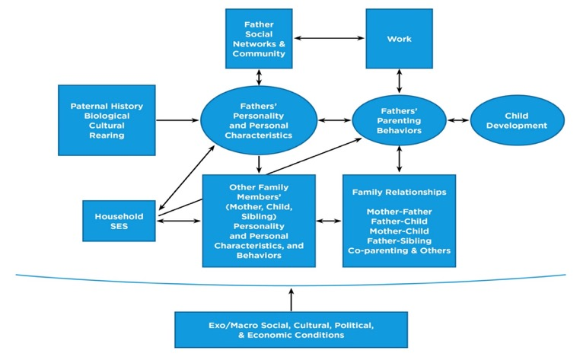
Conceptual Framework to Guide Father Involvement Research
Cabrera, N., Fitzgerald, H. E., Bradley, R. & Roggman, L,. (2014),

Slide 38
Father Absence is Related to Son’s Negative Pathways:
Cognitive Development
Poor school achievement
Lower scores on intelligence tests
Lower grade point averages
Trouble with mathematical and puzzle tasks
Higher likelihood of being expelled, drop out
Lower higher education attainment.
Developmental Psychopathology
Suicide
Deviant peer group selections
High rates of physical and sexual abuse
Higher rates of aggression, bullying, and antisocial behavior
Higher rates of involvement with the criminal justice system
Higher rates of alcohol and other drug problems
Earlier onset of sexual intercourse, smoking and AUD
Higher probability of possessing weapons
Social, Emotional and Moral Development
Poor moral development
Difficulty delaying gratification
More impulsivity
A weaker sense of right and wrong
Social and emotional maladjustment
Conduct and anxiety disorders

Slide 39
Positive Father Involvement is Associated with
Language and Cognitive Development
More use of 5-W questions in language interactions
Higher school attendance and less problems
More likely to enjoy school
Higher academic achievement, GPA, test scores
Better problem solving skills
More self-direction and initiative
Social, Emotional & Moral Development
High life satisfaction
More playful
More socially competent
More socially mature
Better capacity for relatedness
More positive peer relationships
Better sibling relationships
More tolerant and understandig
Stronger moral values
Developmental Psychopathology
Less depression
Less stress and frustration
Less antisocial behavior
Less bullying
Fewer behavior problems, especially externalizing
Less involved with criminal justice system

Slide 40
Attachment Theory vs. Activation Theory and Child Confidence: Thinking differently about father’s parental role
Relationship Theory | Parental Role | Parental Behavior | Primary Parent
Attachment | Sensitivity to children in times of distress | Stay in close proximity (secure base) | Mother
Activation | Encourage risk taking, exploration | Discipline (limit setting, self control) | Father
Activation scores for boys are significantly higher than for girls
24.1 percent of boys had disorganized attachments with father
Confident toddlers engage in more rough and tumble play with fathers at age 3.
Paquette, D., & Dumont, C. (2013).

Slide 41
Father Intervention Programs: Fletcher
SMS4dads
SMS4dads provides new fathers with information and connections to online services through their mobile phones. The text messages with tips, information and links to other services help fathers understand and connect with their baby and support their partner. Results from the feasibility study are encouraging. Of the 520 enrolled, 22% indicated distress and 87% received all messages.
Evaluations on exit were overwhelmingly positive with 92% indicating that SMS4dads had helped them in their transition to becoming fathers and 83% responded that the program had helped their relationship with the mother
Fletcher, R. MacDonald & St. George (in press)

Slide 42
SMS4Dads Replication Studies
SMS4Perinatal Parents | Queensland | Sending messages to mothers with severe mental illness and their partners
SNS4Dads | South Australia | Version II
SNS4Families | Victoria | Messages for mothers and fathers with Primary Health Network
SMS4Dads | Aboriginal fathers | Part of Stavin on Track project
SMS4dnm | New South Wales | Messages to mothers and fathers in Hunter valley

Slide 43
Supporting Father Involvement: Pruett & Pruett
We rely on two decades of the Supporting Father Involvement (SFI) program as an example of an initiative that has been effective at recruiting and retaining fathers and mothers in various cultural and national contexts.
When programs are inclusive in content and focus on process, are sensitive to differences within and across families, and recognize parents as experts on their children, they are more successful in recruiting and retaining diverse groups of fathers and families.
SFI has been linked to reducing couple conflict, anxious and harsh parenting, and enhanced child outcomes.
Has been applied to diverse populations with generally equal success.
Pruett & Pruett (in press)

Slide 44
BEHAVIORAL TRAINING APPROACHES (DeGarmo)
Using a father-centric perspective, we developed evidence-based behavioral parent training specifically for fathers.
The focus is on cognitive and behavioral moderators that can be utilized for adapting curricula and intervention content to be more salient for participating fathers and in turn enhance effectiveness.
Adaptive intervention designs are also introduced and illustrated as a rigorous formal way to test modifications to existing programs specifically for fathers
DeGarmo, in press

Slide 45
Intersubjectivity and Meaning Making
All relationship based theories support the notion that,
“children derive meaning about themselves through parent-child interactions, determining constructed paradigms of self, other, and self-other relationships.”
Relationship dynamics also generate intersubjectivity, or the construction of the phenomenological or existential self.
Bocknek, Brophy-Herb, Fitzgerald, Burns-Jager, & Carolan, (2012).

Slide 46
Exposure to Neighborhood Deprivation at Age 2 and Conduct Problems at Age 9
“Repeated exposure to expressions of hostility, anger, and distress in the neighborhood may facilitate the development of negatively-oriented knowledge structures, which likely become consolidated as internal mental representations of distrust and suspicion of others’ intentions.”
Galan, Shaw, Dishion, & Wilson, (2016

Slide 47
Perspective taking:
Early experience with intersubjectivity facilitates the development of neurobiological underpinnings for perspective taking or mentalization—the ability to imagine another’s viewpoint and understand what might be motivating their behavior, a critical capacity for effective human relations. (p 79).
Narvaez, D. (2014).

Slide 48
Mental Representations: Priming Set Points for Developmental Outcomes (Birth to Five)
Self Reflections on Experience
Risky
Self Representation
Information Processing
Family Dynamics
Mental Representations
Behavior
Self-Object (Other) Differentiation
Expectancies
Biological Processes and Set Points
Affective Load
Co-Constructed Reflections on Experience
Self-Other Relationships
Resilient
Intersubjectivity
Adapted from Fitzgerald, Wong & Zucker (2012). In N. E. Suchman, M. Pajulo, & L. C. Mayes (eds). Parenting and substance addiction: Developmental approaches to intervention. New York: Oxford University Press.

Slide 49
Contact Information
Hiram E. Fitzgerald, Ph.D
University Distinguished Professor,
Department of Psychology
219 South Harrison Road
Michigan State University
East Lansing, MI 48824-1022
Phone: (517) 353-8977
Fax: (517) 432-9541
fitzger9@msu.edu
Some of the research discussed in this report was supported, in part, by grants NIAAA R37 AA 07065, R01 AA 12217, and T32 AA 07477 (Robert A Zucker (PI).
© 2010 Michigan State University Board of Trustees

Slide 50
References
August, .G. J., & Gewirtz, A. (2019). Moving toward a precision-based, personalized framework for prevention science: Introduction to the Special Issue. Prevention Science, 20, 1-9.
Bocknek, E. L., Brophy-Herb, H. E., Fitzgerald, H. E., Burns-Jager, K., & Carolan, M. T. (2012). Maternal psychological absence and toddlers’ social-emotional development: Interpretations from the perspective of boundary ambiguity theory. Family Process, 51, 527-541
Cicchetti, D. & Rogosch, F. A. (2018). A developmental psychopathology perspective on substance use: Illustrations from the research on child maltreatment. In H. E. Fitzgerald & L. I. Puttler (eds). Alcohol use disorders: A developmental science approach to etiology (pp 17- 29). New York: Oxford University Press.
Dai, J., et al. (2016). Influence of paternal preconception exposures on their offspring: through epigenetic to phenotype. American Journal of Stem Cells, 5, 11-18.
DeGarmo, D. S. (in press). Designing and Tailoring Preventive Interventions for Fathers’ Parenting. In H. E. Fitzgerald et al. (Eds). Handbook on Fathers and Child Develoment: Penatal to Preschool. Springer.
Doidge, J. C. (2016). The epidemiology of adverse childhood experiences in Australia. Doctoral dissertation, University of South Australia, Adelaide
Drury, S.S., Theall, K.,…..Nelson, C.A. (2012). Telomere length and early severe social deprivation: linking early adversity and cellular aging. Molecular Psychiatry, 17, 719-727.
Eme, R. E. (2007). Sex differences in child onset, life-course persistent conduct disorder. A review of biological influences. Clinical Psychology Reviews, 27, 6-7-627
Entringer, S., Epel, E. S. ……Wadhwa, P.D. (2011). Stress exposure in intrauterine life is associated with shorter telomere length in young adulthood. Proceedings of the National Academy of Sciences, 108 (33), E513-E518.
\
Fletcher, R., MacDonald, J. A., & St. George, J. M. (in press). Connection, IT and Identity: SMS4dads as Health Promotion for New Fathers . In H. E.,, Fitzgerald et al (Eds). Handbook on Fathers and Child Development: Prenatal to Preschool. Springer
Entringer, S., Epel, E. S. ……Wadhwa, P.D. (2011). Stress exposure in intrauterine life is associated with shorter telomere length in young adulthood. Proceedings of the National Academy of Sciences, 108 (33), E513-E518.
Evaus, G. W., & Kim, P. (2012). Childhood poverty and young adults: allostatic load. The mediating role of childhood cumulative risk exposure. Psychological Science, 23, 979-983.
Fitzgerald, H. E., Sullivan, L. A., Zucker, R. A., Bruckel, S., Schneider, A. M., & Noll, R. B. (1993) Predictors of behavioral problems in three-year-old sons of alcoholics: Early evidence for onset of risk. Child Development, 64, 110-123.

Slide 51
Golding, P., & Fitzgerald, H. E. (2019). The biopsychosocial determinants of prenatal, infant, and toddler boys and the origins of violence of in males. Infant Mental Health Journal, 40, 5-22.
Hartung, C. M., & Lefler, E. K. (2019). Sex and gender in psychopathology: DSM-5 and beyond. Psychological Bulletin, 145, 390-409
Jaffe, S. R. (2019). Lead exposure and child maltreatment aas models for how to conceptualize early-in-life risk factors for violence. Infant Mental Health Journal, 40, 23-39.
Jester, J. M., Buu, A., & Zucker, R. A. (2016). Longitudinal phenotypes for alcoholism: Heterogeneity of course, early identifiers, and life course correlates. Developmental and Psychopathology, 28, 1531-1546.
Jester, J. M., Nigg, J. T., Buu, A., Puttler, L. I., Glass, J. M., Heitzeg, M., Fitzgerald, H. E., & Zucker, R. A. (2008). Trajectories of childhood aggression and inattention hyperactivity: differential effects on substance abuse in adolescence. Journal of the American Academy of Child and Adolescent Psychiatry, 47, 1158-1165.
Kertes, D. A., Kamin, H. S., Hughes, D. A., Rodney, N. C., Bhatt, S., & Mallieun, C. J. (2016). Prenatal maternal stress predicts methylation of genes regulating the hypothalamic-pituitary-adrenocortical system in mothers and newborns in the Democratic Republic of Congo. Child Development, 87, 61-72.
Lester, B. M., Conradt, E. & Marsit, C. (2016). Introduction to special section on epigenetics. Child Development, 87, 29-37
Liu, J. H., et al. (2004). Malnutrition at age 3 years and externalizing problems at age 8, 11, 1nd 17. American Journal of Psychiatry, 161, 2005-2013.
Mayzer, R., Fitzgerald, H. E. & Zucker, R. A. (2009). Anticipating early problem drinking from antisocial behavior in preschool and thereafter: Testing a hard continuity model. Journal of the American Academy of Child and Adolescent Psychiatry, 48, 820-827.
Mitchell, C., Hobcraft, J. McLanahan, S. S., Siegel, S. R., Berg, A., Brooks-Gunn, J…..Notterman, D. (2014). Social disadvantage, genetic sensitivity, and children’s telomere length. Proceedings of the National Academy of Sciences, 111 (16), 5944-5969.
Narvaez, D. (2014). Neurobiology and the development of human morality: Evolution, culture, and wisdom. New York: W. W. Norton.
Paleva, M., Peshevska, D. J., & Sethi, D. (2013). Survey of adverse childhood experiences among young people in the former Yugoslav Republic of Macedonia. World Health Organization

Slide 52
Pruett, K., & Purett, M.K. (in press). Engaging Fathers of Young Children in Low Income Families to Improve Child and Family
Outcomes: An Intervention and Prevention Perspective. In H. E., Fitzgerald et al. (eds). Handbook of Fathers and Child Development: Prenatal to Preschool. Springer.
Puttler, L. I., Zucker, R. A., & Fitzgerald, H. E. (2018). Developmental science, alcohol use disorders, and the risk-resilience contimuum. In H. E. Fitzgerald & L I. Puttler (Eds). Alcohol use disorders: A developmental science approach to etiology (pps 5 – 16). NewYork: Oxford University Press.
Raine, A. (2019). A neurodevelopmental perspective on male violence. Infant Mental Health Journal, 40, 84-112.
Sacks, V., Murphey, D., Moore, K. (2014). Adverse childhood experiences: National and state-level prevalence. Washington, DC: Child Trends. Childtrends.org
Schulenberg, J., Maslowsky, J., & Jager, J. (2018). Substance use and abuse during adolescence and transition to adulthood are developmental phenomena: Conceptual and empirical considerations. In H. E. Fitzgerald & L. I. Puttler (eds). Alcohol use disorders: A developmental science approach to etiology (pp 199-221). New York: Oxford University Press
Shaw, D. S., & Gilliam, M. (2017). Early Childhood Predictors of Low-Income Boys’ Antisocial Behavior from Middle Childhood Through Early Adulthood, Infant Mental Health Journal, 39, 68-83.
Tembley, R. E. & Cote, S. M. (2019). Sex differences in the development of physical aggression: an intergenerational perspective and implications for preventive interventions. Infant Mental Health Journal, 40, 129-140.
Twitchell, G. R., Hanna, G. L., Cook, E. H., Fitzgerald, H. E., & Zucker, R. A. (2000). Serotonergic function, behavioral disinhibition, and negative affect in children of alcoholics: The moderating effects of puberty. Alcoholism: Clinical and Experimental Research, 24, 972-979.
Zucker, R.A., Hicks, B. M., & Heitzeg, M. M. (2016). Alcohol use and alcohol use disorders over the life course: A cross-level developmental review. In D. Cicchetti (Ed.), Developmental psychopathology: Vol. 3, Maladaptation and psychopathology (3rd ed.) (chap. 18, pp. 793–832). New York: Wiley.
Zucker, R. A., Kincaid, S. B., Fitzgerald, H. E., & Bingham, C. R. (1995). Alcohol schema acquisition in preschoolers: differences between COAs and Non-COAs. Alcoholism: Clinical and Experimental Research. 19, 1011-1017.

