Slide 1
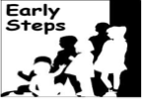
The role of early discrimination experiences and the parent-child relationship in the development of disruptive behaviors in adolescence*
Melvin N.Wilson
*Presentation is based on an article by
Shannon M. Savell _{B.A.}, Sean R. Womack _{B.S.}, Melvin N. Wilson _{PhD}, Daniel S. Shaw _{PhD} Thomas J. Dishion _{PhD}

Slide 2
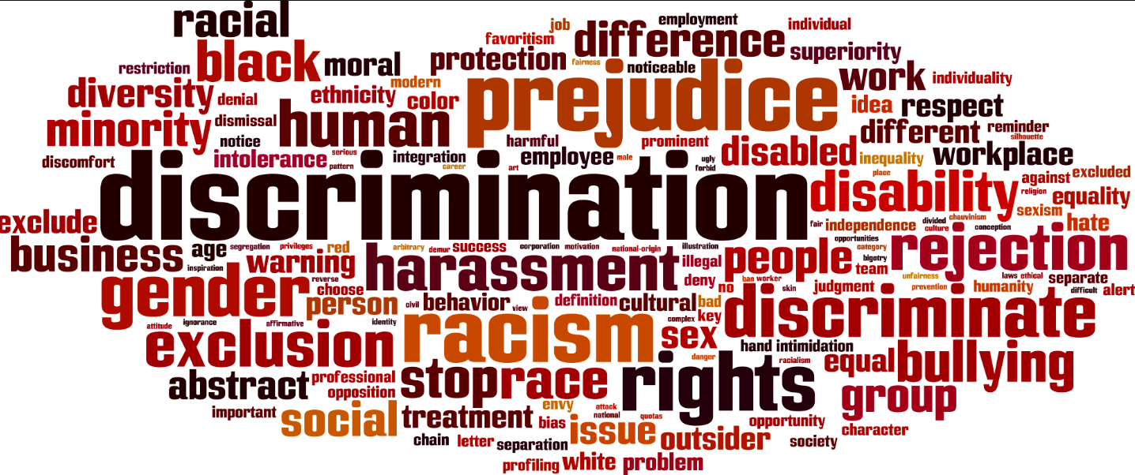
Notes:
Discrimination, or the unfair or prejudicial treatment of different categories of people based on features such as race, gender, religion, income, is extremely prevalent in American society. Furthermore, a nationally representative study, racial and socioeconomic discrimination were found to be quite pervasive in the United States (Ren, Amick, & Williams, 1999).

Slide 3
Notes:
Discrimination has been shown to be related to diminished psychological adjustment (Clark, Coleman & Novak, 2004) and greater risk for substance use (Gibbons et al., 2010) when personally experienced by adolescents and when their caregivers experience discrimination (Ford et al., 2013).

Slide 4
Notes:
The present study contributes to the growing literature on the impact of caregiver discriminatory experiences on child behavior. Further, we examine family processes that may attenuate the negative effects of discrimination. Taking an ecological systems perspective (Bronfenbrenner, 1979), discrimination may be most impactful on child development via processes occurring at the level of the microsystem (e.g., parent-child relationships). For example, parents may become depressed in response to discrimination experiences and utilize poorer parenting strategies, leading to maladaptive child behaviors (Anderson et al., 2015).

Slide 5
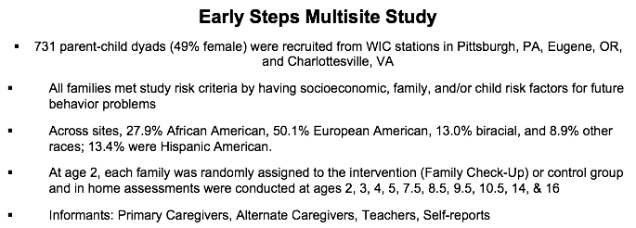
Notes:
The present study sample is from the Early Steps Multisite Study, a longitudinal intervention project in Cville, Pittsburg & Eugene that has followed the target children and their caregivers from age 2 to age 14. The families are primarily from low income backgrounds and are from diverse racial and ethnic backgrounds such as African American, European American and Hispanic American.
Our findings are unique in that they address the impact of racial and socioeconomic based discrimination experienced by their primary caregiver on later child disruptive behavior in adolescence with a large sample of caregiver-child dyads (N = 634) from diverse racial/ethnic backgrounds.

Slide 6
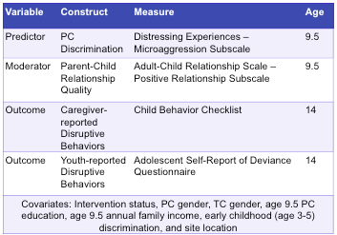
Measures
Notes:
For the predictor variable we used the Microaggression Scale (MIC; adapted from Walters, Simoni, & Evans-Campbell, 2002), administered at the age 9.5 assessment. The MIC is an 9-item measure assessing experiences of ethnic/racial and income discrimination from others. Parents rated the frequency of discrimination in specific situations that they faced between child ages 7.5 and 9.5 (e.g., “Have you ever been expected to act in a stereotypical manner because of your ethnicity/race? because of your income?”) on a 5-point scale ranging from “almost never” to “almost always.”
For the moderator variable we the the positive relationship scale on the Adult Child Relationship Scale (ACRS) at the age 9.5 assessment. A sample item from the positive relationship scale is “If upset, this child seeks comfort from me.” Responses were on a 5-point Likert scale ranging from Definitely Not to Definitely.
For the outcome variable we used a latent variable approach with caregiver report of child behavior and target child self report of behavior. Caregiver-reported disruptive behaviors. Caregiver assessments of adolescent disruptive behaviors were assessed using the Child Behavior Checklist (CBCL) at age 14. The CBCL is a 76-item parent report of emotional and behavior problems in children over the past 6 months (Achenbach & Rescorla, 2001). A 3-point Likert scale (0 = not true, 1 = somewhat or sometimes true, 2 = very true or often true) was used to assess parental perceptions of child behavior (e.g., “My child is inattentive or easily distracted”).
Youth-reported disruptive behaviors. Target youth completed an adapted version of the Self Report of Delinquency Questionnaire (SRD; Elliot, Huizinga, & Ageton, 1985). The 46-item SRD assesses the frequency of aggressive and delinquent behaviors an individual has engaged in over the past 12 months. Responses are coded on a 3-point Likert scale (0 = never, 1 = once/twice, 2 = more often). Sample items include, “Have you cheated on school tests?; Have you stolen or tried to steal a bicycle or skateboard?; Have you been arrested?”

Slide 7
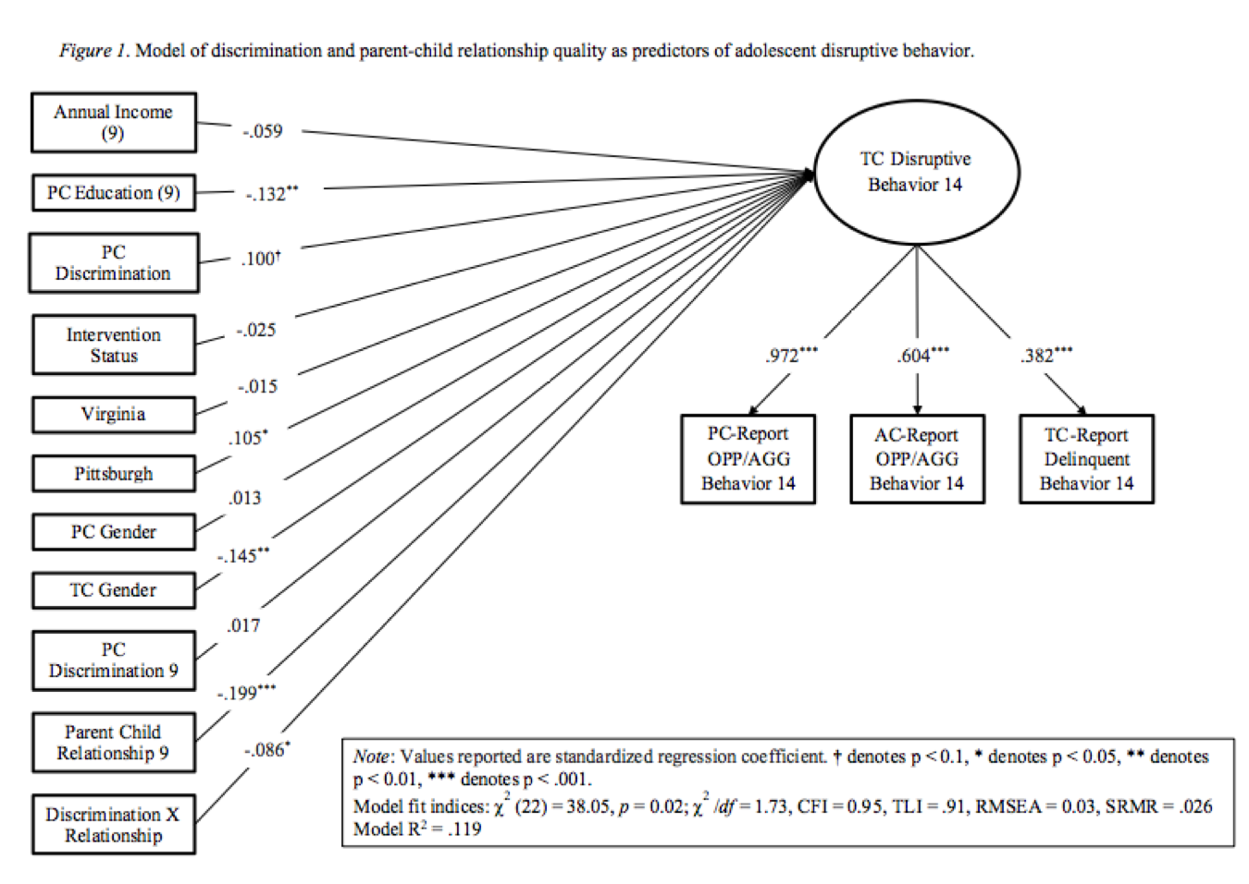
Results
Notes:
All models controlled for intervention status, PC gender, TC gender, age 9.5 PC education, age 9.5 annual family income, early childhood (age 3-5) discrimination, and site location with Eugene used as the reference group.
The primary study hypothesis was examined with a structural equation model (SEM) in the ‘lavaan’ package version 0.523.1097 in R using maximum likelihood estimation with robust estimators (MLR; Rosseel, 2012).
Model fit was assessed for the model using the following fit indices listed here.
On the right you will notice the latent variable of disruptive behaviors which takes into account the primary caregiver report, the alternate caregiver report, and self report. This method was used to reduce reporter bias.

Slide 8
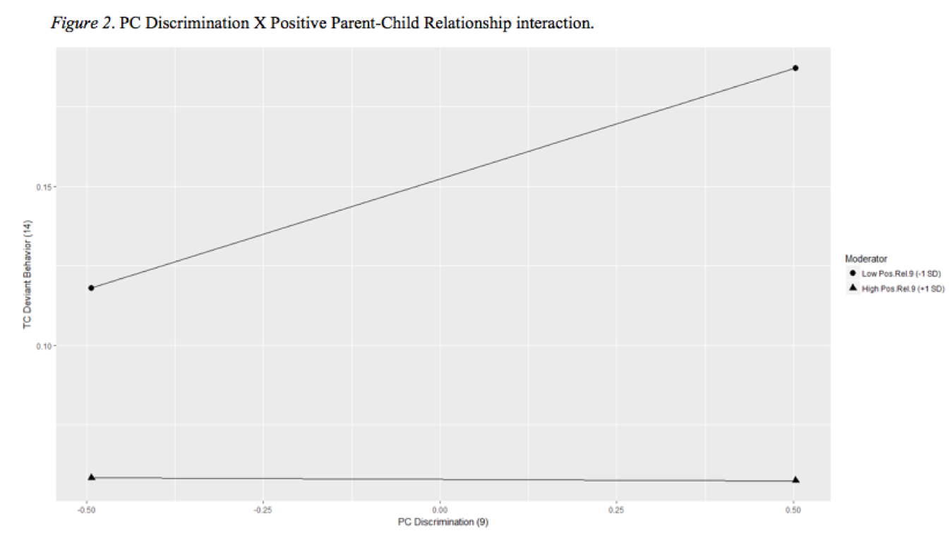
Results
PC Discrimination
Notes:
To help you orient to the graph along the X axis you will see PC reports of discrimination from half a standard deviation below the mean on the far left to a half a standard deviation above the mean on the far right.

Slide 9
Results
TC Disruptive Behavior
PC Discrimination
Notes:
Along the Y axis you will see levels of TC disruptive behavior as indicated by the factor score on the latent variable discussed in the previous slide.

Slide 10
Results
TC Disruptive Behavior
High Positive Parent-Child Relationship Quality
PC Discrimination
Notes:
The bottom line represents high or 1 standard deviation above the mean parent child relationship quality.

Slide 11
Results
Low Positive Parent-Child Relationship Quality
TC Disruptive Behavior
High Positive Parent-Child Relationship Quality
PC Discrimination
Notes:
The top line represents low or 1 standard deviation below the mean parent child relationship quality.

Slide 12
Results
Low Positive Parent-Child Relationship Quality
TC Disruptive Behavior
High Positive Parent-Child Relationship Quality
PC Discrimination
Notes:
First you will notice that overall for target children with a high positive relationship with their primary caregiver there are lower levels of disruptive behavior.
Second as I noted earlier the simple slope tests were conducted and revealed significant differences in slope such that even when their caregivers are experiencing high levels of discrimination the high positive relationship is able to buffer effects on behavior whereas in the face of frequent discrimination and a low positive relationship the negative effects on behavior are even more pronounced.
Specifically, simple slope tests were conducted at high (1 SD above the mean) and low (1 SD below the mean) positive parent-child relationship scores.

Slide 13
Discussion
TC Disruptive Behavior
PC Discrimination
Notes:
Consistent with study hypotheses, parent’s experiences of discrimination in late childhood predicted target child’s adolescent disruptive behaviors.

Slide 14
Discussion
In the context of High Positive Parent-Child Relationship Quality
TC Disruptive Behavior
PC Discrimination
Notes:
Also, consistent with study hypotheses, the association between parent’s experiences of discrimination in late childhood and disruptive behavior in adolescence decreased in magnitude in the context of a positive parent-child relationship. The attenuating effect of a positive parent-child relationship is consistent with previous studies that indicate a more positive parent-child relationship is associated with fewer problem behaviors (Qu, Fuligni, Galvan, & Telzer, 2015). Parents that are able to foster positive relationships with their children may be better able to recognize and attend to emotional and conduct problems and alleviate issues that may be causing such problems.
Alternatively, it is possible that a having a positive parent-child relationship may attenuate the parent’s internal distress following experiences of discrimination. That is, having consistent positive interactions with one’s children may foster resilience for the parent through increasing parenting self-efficacy, leading to a lower likelihood of developing depression and an increased likelihood of maintaining positive parenting practices. This, in turn, would serve to strengthen the positive parent-child relationship. Consistent with this hypothesis, parenting self-efficacy has been linked to better parental psychological functioning and more positive parenting practices (Jones & Prinz, 2005).

Slide 15
Conclusions
Notes:
The findings highlight the need for prevention and intervention techniques. Specifically, fostering healthy positive primary caregiver-child relationships may be one means by which to intervene.

Slide 16
Conclusions
Notes:
The findings highlight the need for prevention and intervention techniques. Specifically, fostering healthy positive primary caregiver-child relationships may be one means by which to intervene.

