Slide 1
Boys at Risk II
Early Origins of Male Violence
Paul Golding, PhD
Santa Fe Boys Educational Foundation
www.santafeboys.org

Slide 2
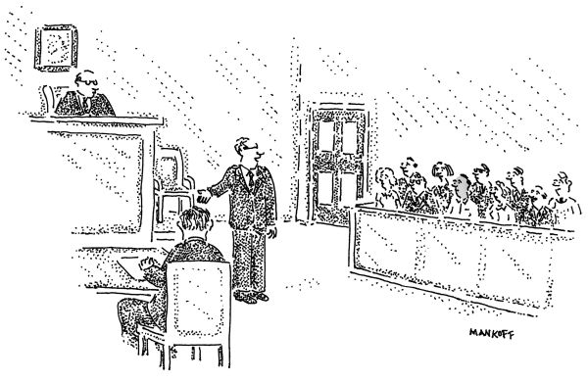
So, before passing judgment, please consider that science now shows that the male brain is not fully developed until never.

Slide 3



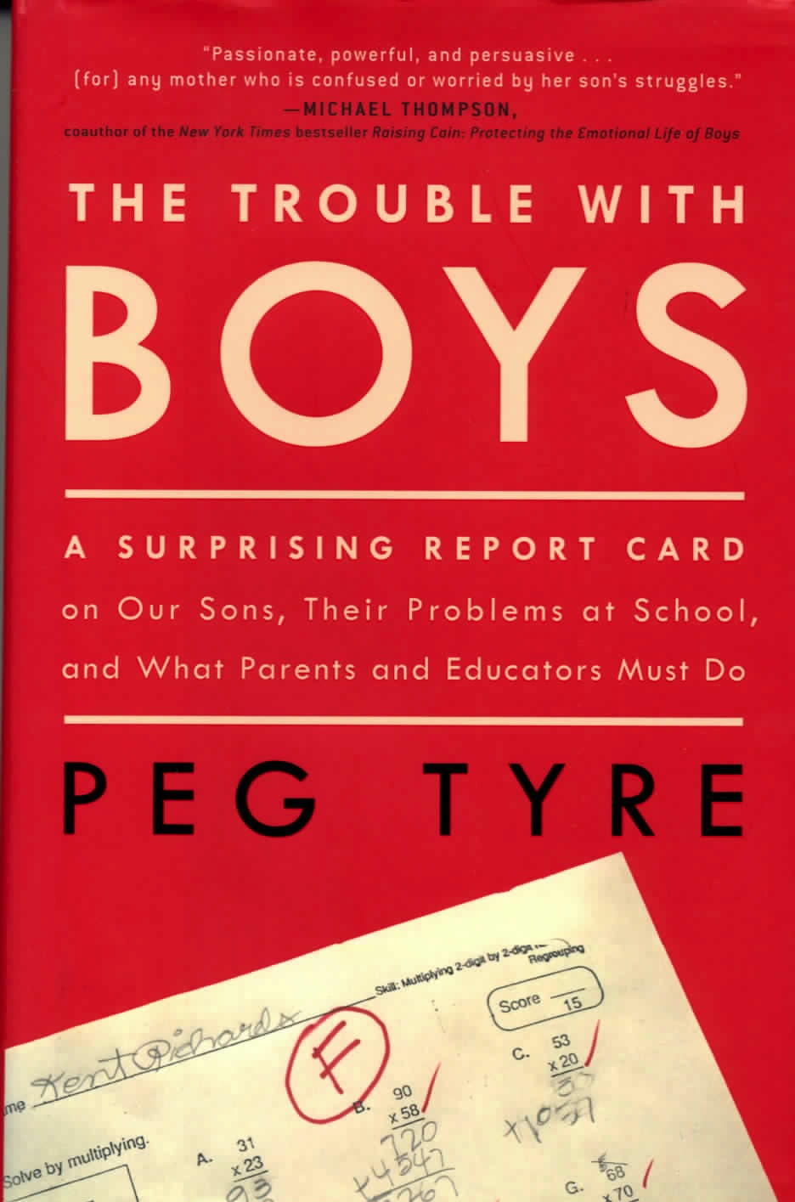











Boy Crisis Literature

Slide 4
CDC Mental Health Surveillance among Children, United States, 2005-2011
Sex | Prevalence of Mental, Behavioral, or Developmental Disorders, Age 2-8 Years
Male | 19.5%
Female | 11.0%
Source: Centers for Disease Control and Prevention. (2016, March 11). Health care, family, and community factors
associated with mental, behavioral, and developmental disorders in early childhood – United States,
2011-2012. Retrieved from https://www.cdc.gov/mmwr/volumes/65/wr/mm6509a1.htm?s_cid=mm6509a1_w
Among Children less than 18: “Boys were more likely than girls to have most of the disorders
including ADHD, behavioral and conduct problems, ASD, anxiety, Tourette syndrome,
cigarette dependence, and boys were more likely to die by suicide. Girls were more likely
to have an alcohol use disorder, and adolescent girls were more likely to have depression.”
Source: Centers for Disease Control and Prevention. (2013, May 17). Mental Health Surveillance
among Children—United States, 2005-2011. Retrieved from http://www.cdc.gov/mmwr/pdf/oher/su6202.pdf

Slide 5

An Issue Whose Time Has Come: Sex/Gender Influences on Nervous System Function

Slide 6
Number of sentenced prisoners under the jurisdiction of
state correctional authorities for violent crimes, Dec 31, 2014
 | All Prisoners | Male | Female | White | Black | Hispanic
All Violent Crime | 696,900 | 663,600 | 33,500 | 210,400 | 263,800 | 152,900
Percent | 100.00% | 95.22% | 4.81% | 30.19% | 37.85% | 21.94%
Murder | 171,700 | 161,500 | 10,300 | 46,000 | 68,100 | 43,700
Percent | 100.00% | 94.06% | 6.00% | 26.79% | 39.66% | 25.45%
Manslaughter | 17,100 | 15,000 | 2,100 | 6,400 | 3,700 | 3,300
Percent | 100.00% | 87.72% | 12.28% | 37.43% | 21.64% | 19.30%
Rape/sexual assault | 162,800 | 160,900 | 2,000 | 71,600 | 36,600 | 31,300
Percent | 100.00% | 98.83% | 1.23% | 43.98% | 22.48% | 19.23%
Robbery | 168,600 | 161,200 | 7,500 | 33,500 | 88,600 | 26,700
Percent | 100.00% | 95.61% | 4.45% | 19.87% | 52.55% | 15.84%
Aggravated/simple assault | 134,400 | 126,600 | 7,800 | 39,000 | 51,200 | 36,400
Percent | 100.00% | 94.20% | 5.80% | 29.02% | 38.10% | 27.08%
Other | 42,200 | 38,500 | 3,800 | 14,000 | 15,500 | 11,400
Percent | 100.00% | 91.23% | 9.00% | 33.18% | 36.73% | 27.01%

Slide 7
So, before passing judgment, please consider that science now shows that the male brain is not fully developed until never.

Slide 8
Summary of Opening Comments:
How Well Will the Conference Address These Questions?
1. Did the conference tell us more generally about a host of grave problems that occur in boys’ lives?
2. Did the conference provide new ways to view and understand boys at risk?
3. With regard to violence, how did the conference address the extreme male predominance?
4. Were we able to see biology as part of the basic repertoire of causes that contribute to boys acting out antisocially?
5. Did the conference encourage considering the bases of violence as deep rooted in spite of the cultural resistance which emphasizes social construction?
6. Are we able to appreciate violence as a complex, almost exclusively male vulnerability with origins in the mixture of biology and psychology, in the context of a larger society where racism, economic inequality, availability of guns, father absence, and many other elements also contribute to the mix?
7. Why is it males who may be White, Black, or another ethnic or racial group who are the ones engaging in violence in such stark and sex-stratified numbers?

