Slide 1
Early Adolescent Males & Violence Mitigation
Fathers New Mexico/ Future Men Project

Slide 2
Fathers New Mexico: Origin
1998/99 New Mexico Young Fathers Project begins. Two sites initiated by Johnny Wilson
2000 Barry McIntosh hired by NMYFP as site coordinator for Santa Fe site
2004 Young Men mentoring group started at Capshaw Middle School. Precursor of Future Men Project
November 2009 NMYFP site closed to lack of funding

Slide 3
Fathers New Mexico: Origin
December 2009 Barry McIntosh founded Young Fathers of Santa Fe
2010 Damon Archuletta and Gabriel Ortega hired
2014 Future Men Project started at Ortiz Middle School. Programs expanded to serve Abq & Central NM
2016 Barry McIntosh retires as Executive Director. Johnny Wilson hired as new ED
2017 Name Changes to Fathers New Mexico - expanded scope of work

Slide 4
Fathers New Mexico: We serve Fathers of all ages

Slide 5
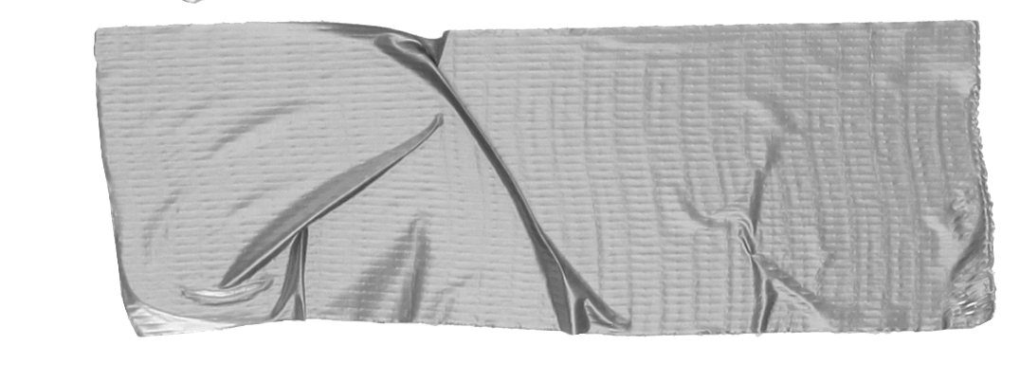
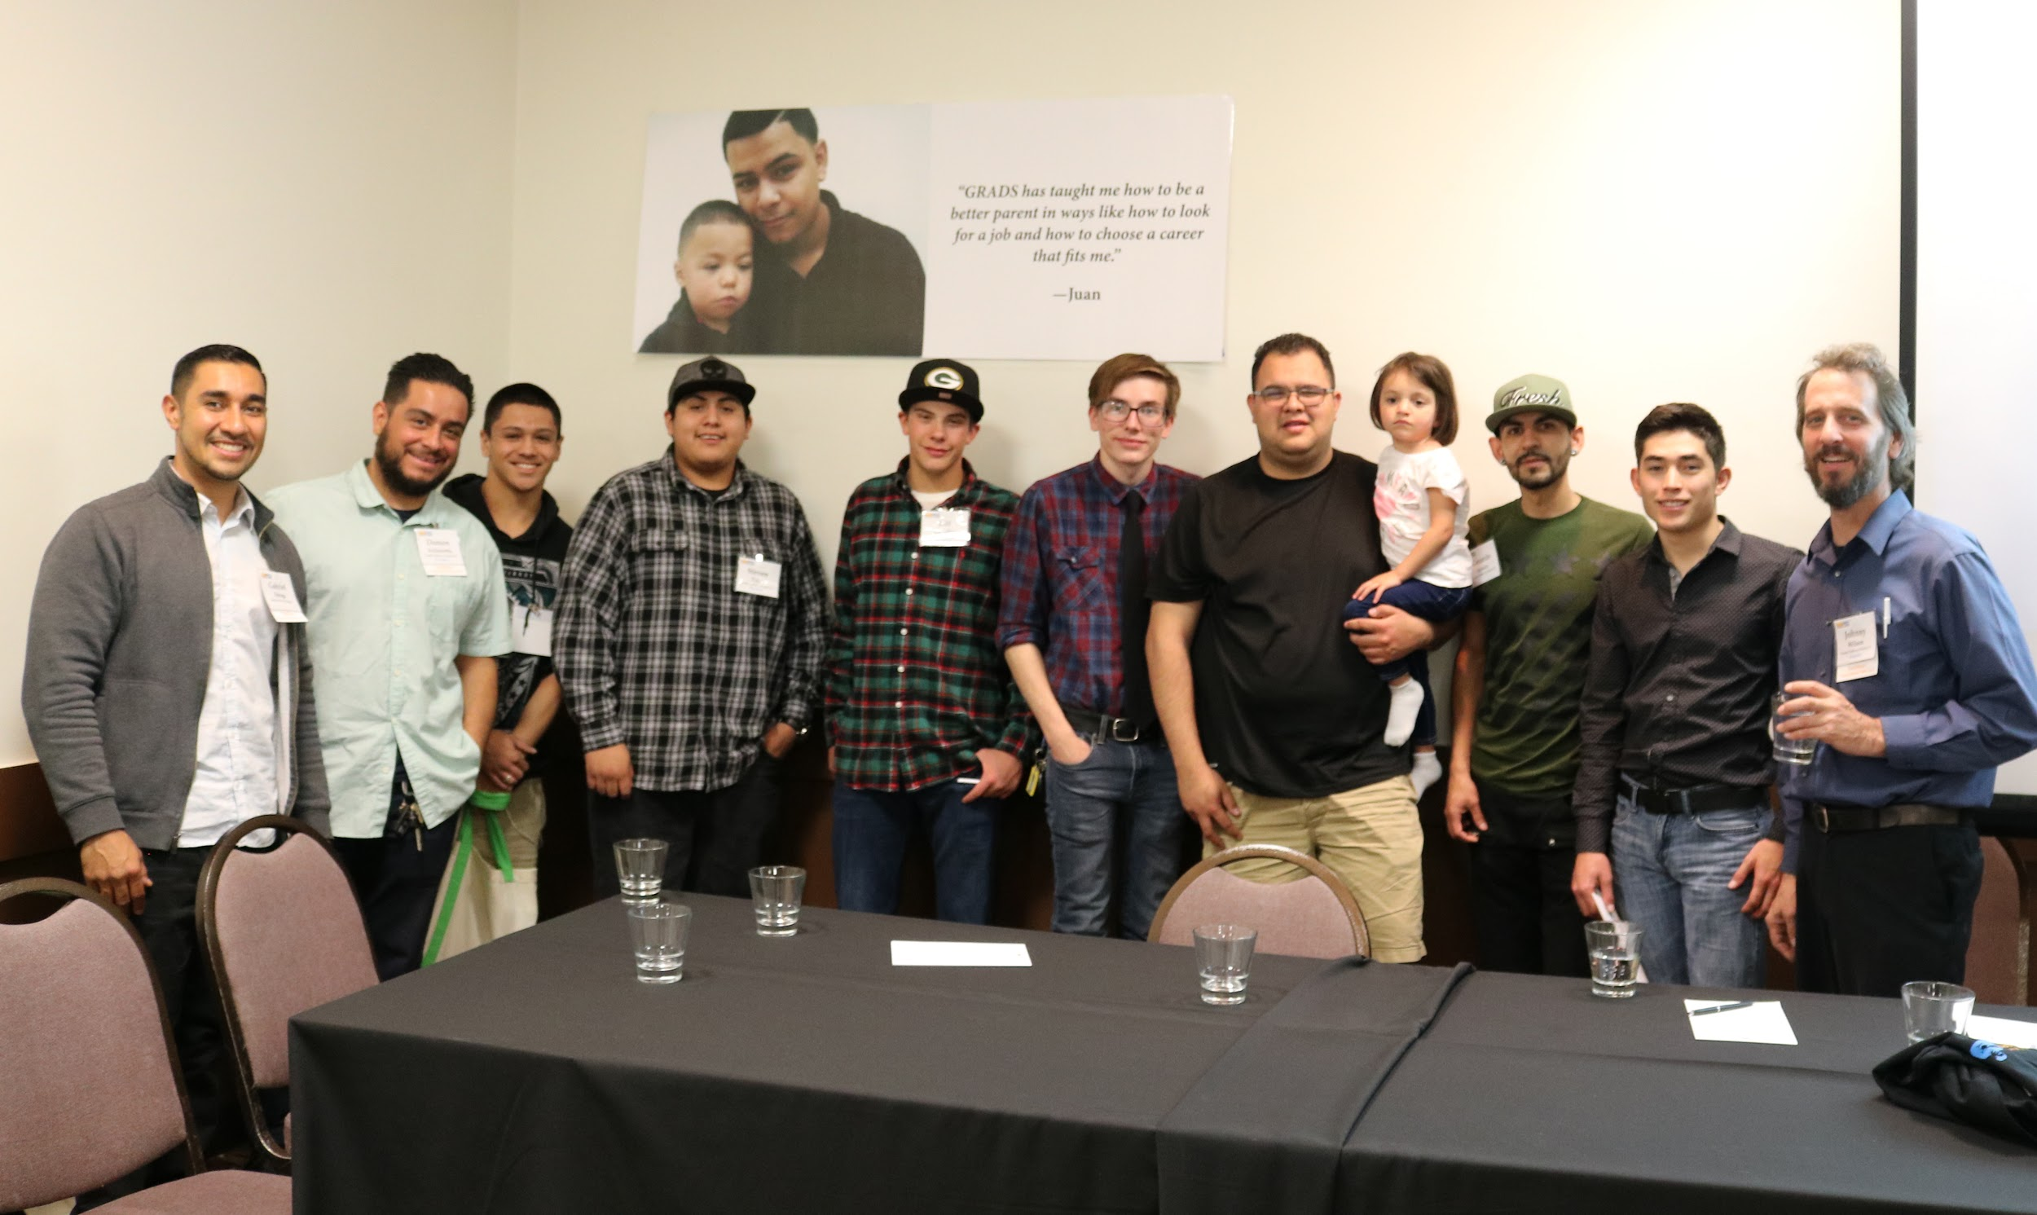
Fatherhood Services
Support the mother/father/child relationship
Connect with fathers early in the pregnancy
Regular case management
Regular support groups
Childbirth preparation training to support involvement
Parenting and relationship skill training
Jobs/housing/education/support
Supporting dads going through family court.

Slide 6
The project that FOUND US!
Our fastest expanding project
Growing organically
At this time comprised of 5th, 6th, 7th, and 8th grade boys

Slide 7
Future Men Project.
Currently holds groups in 4 Middle Schools & 1 Elementary school in Santa Fe
ECRA, Ortiz Middle School, Milagro Middle School, Nava Elementary.
Additionally...
We are increasingly getting requests for groups in Elementary Schools (5th and 6th grade)..

Slide 8
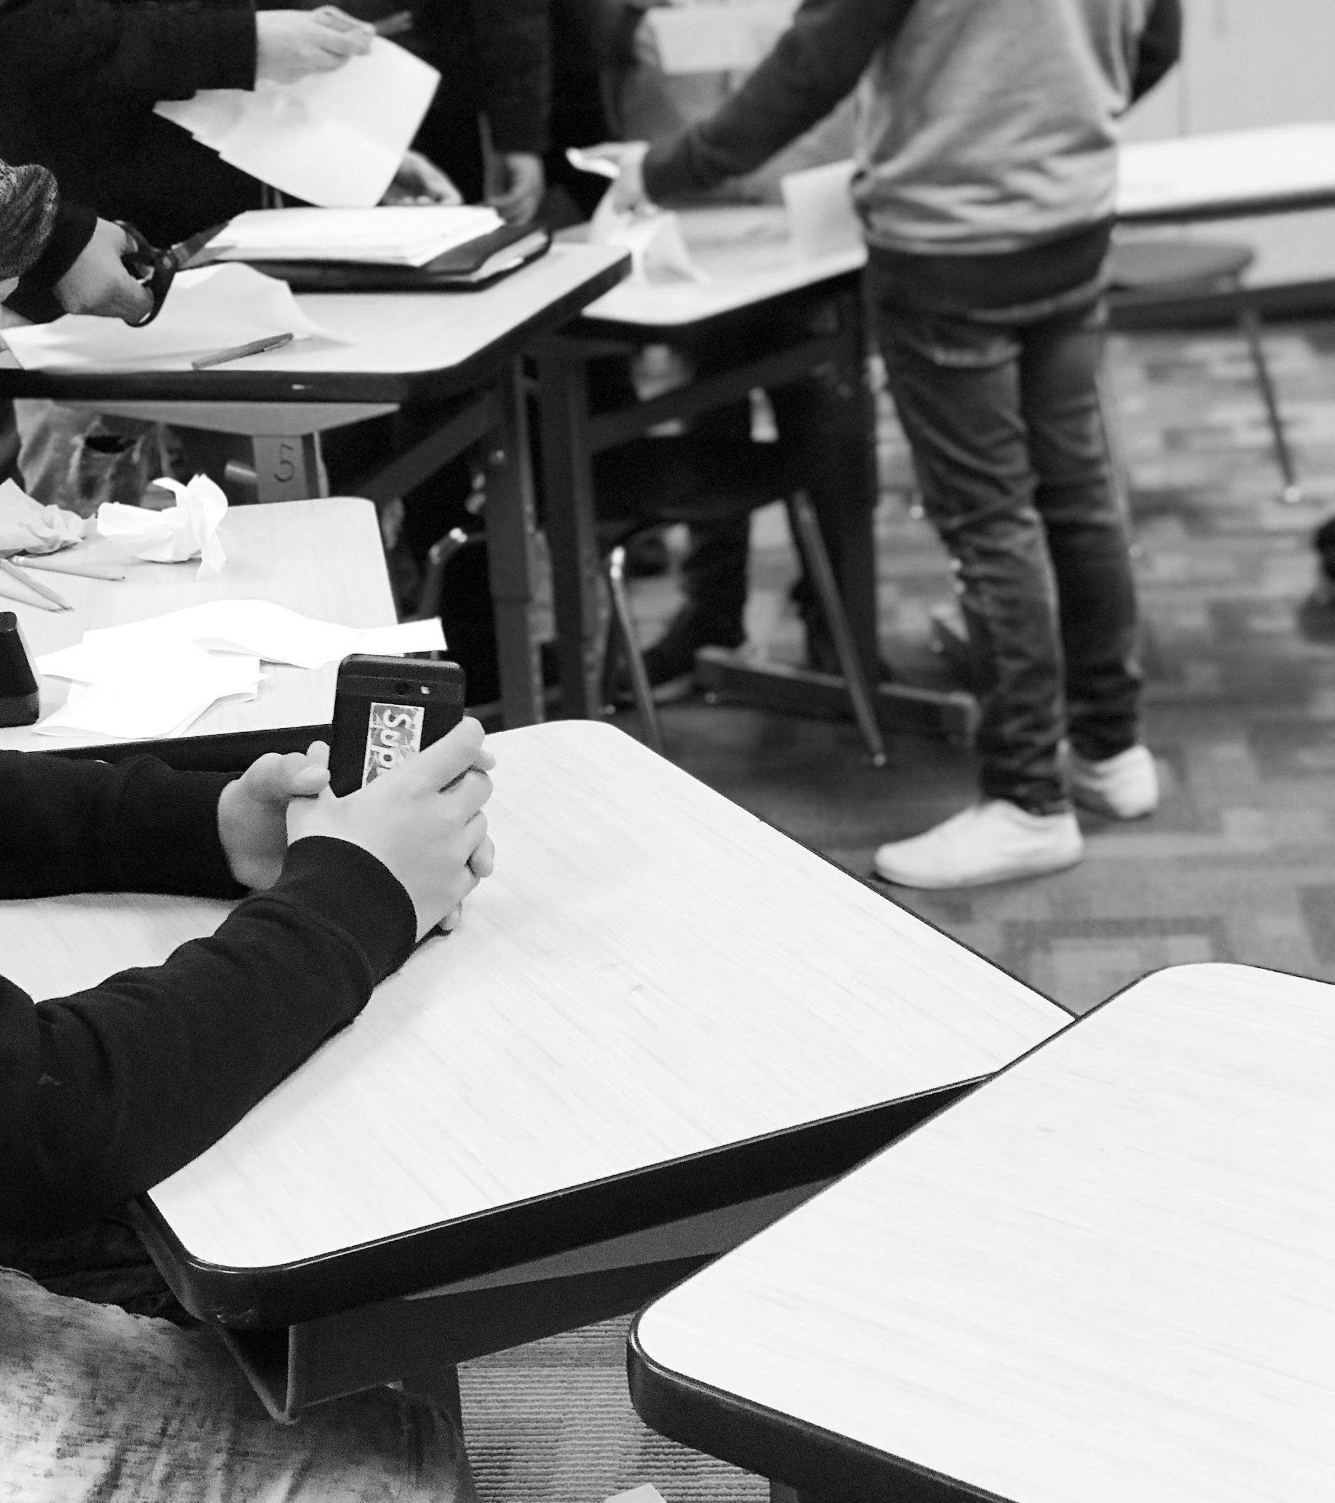
FMP Groups.
Candidates are identified collaboratively by Counselors, CIS site coordinators, teaching staff, and FNM
8-12 boys per group on average
Groups meet for 35-45 minutes depending on class schedule

Slide 9
What can be done in 35-45 minutes with a group of at risk boys to make a positive impact and mitigate violence?

Slide 10
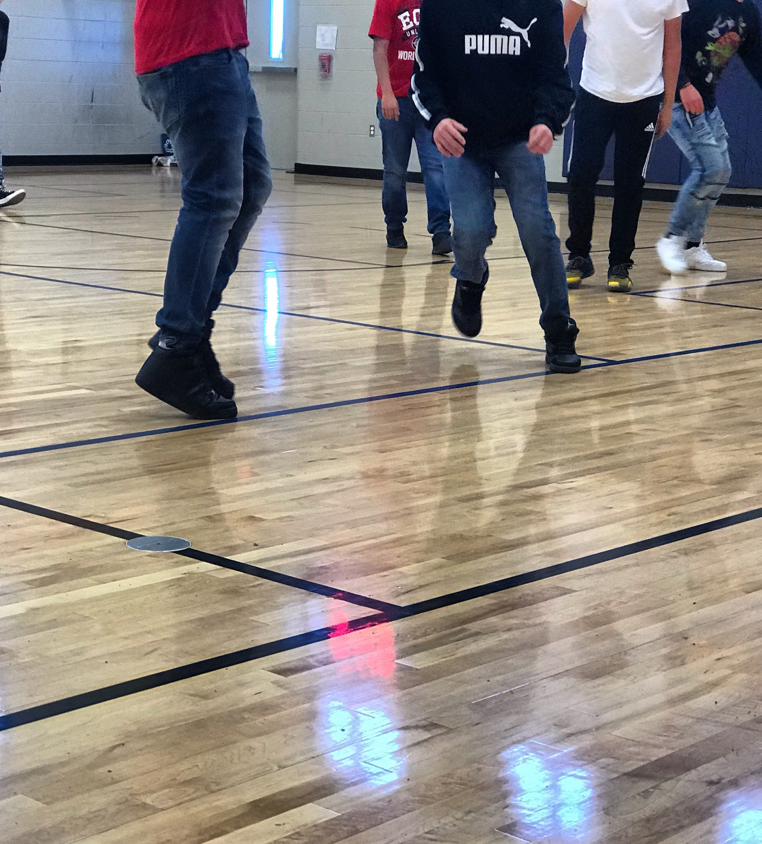
The group gives the opportunity for every participant to be
SEEN, HEARD, and
FEEL CONNECTED
with other group members and an adult mentor who has a genuine interest in what they have to say.

Slide 11
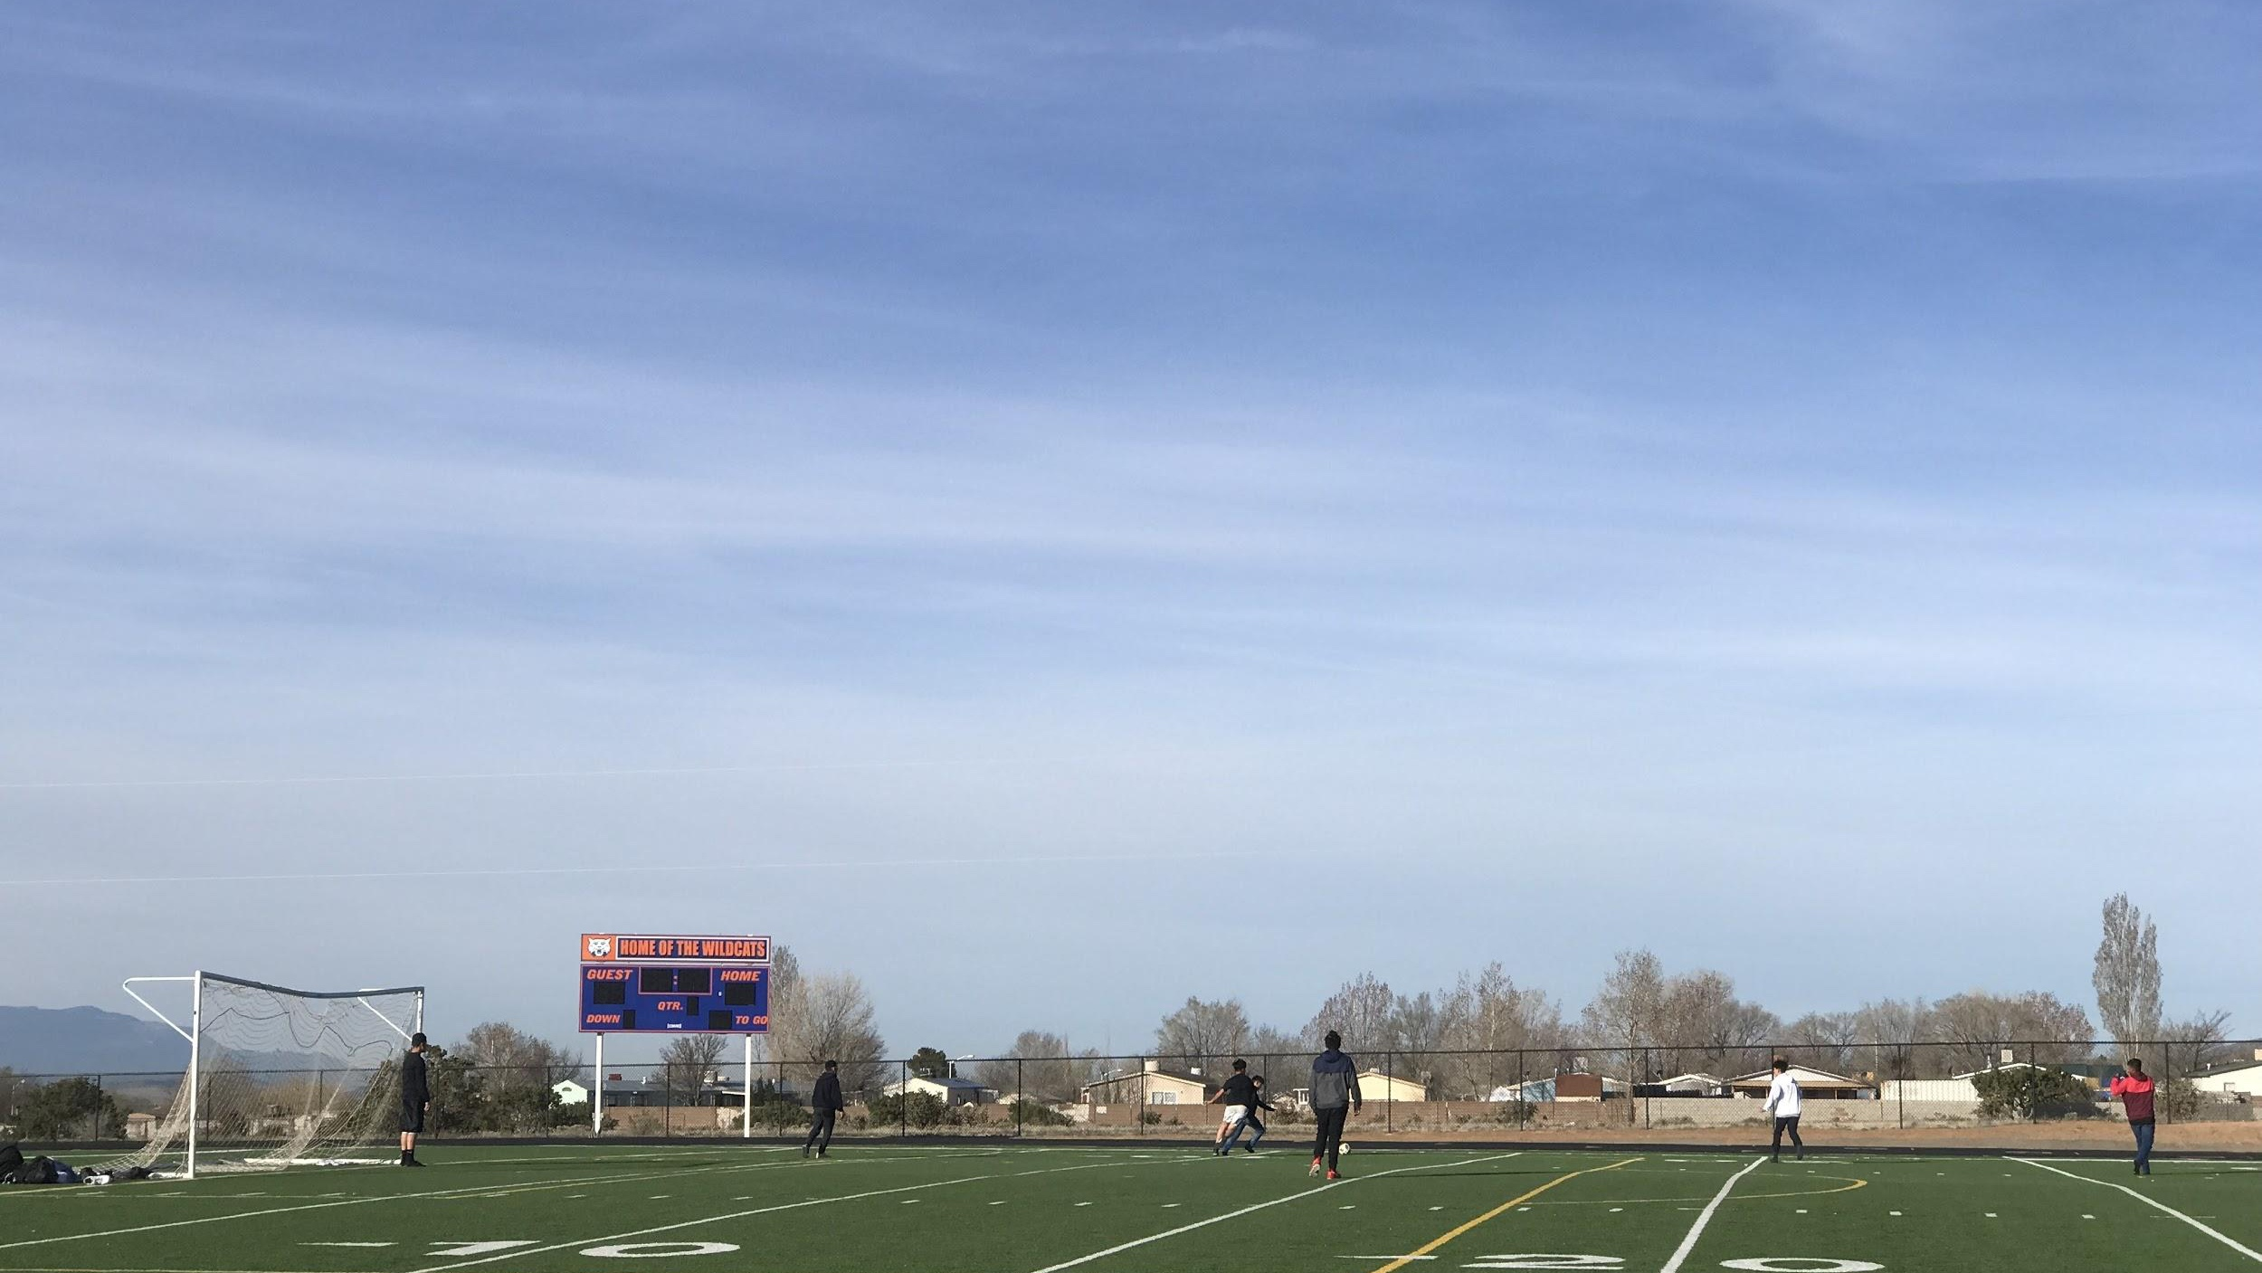
Key Curriculum Goals
Healthy Relationships
Goal Setting
Communication Skills
Healthy Sexuality
Substance Abuse Awareness
Being of Service/ Community Belonging

Slide 12
Agreements
One person speaks at a time
Agree to Disagree
Confidentiality
Every member can speak candidly*

Slide 13
Group structure.
Check In
Share a meal
Lesson or physical activity

Slide 14
What we’ve learned...
From our experiences with FMP groups the following have been helpful to group members...

Slide 15
Adding some wins...
Successful and positive interactions with classmates and adult authority figures.

Slide 16
The need to expand a small world...
The need to see past one's immediate surroundings, introduce new possibilities.

Slide 17
Better to hear from them...
Facilitator speaking less can be more helpful. Take a genuine interest in each group member.

Slide 18
Hear the group in a non-judgemental way...
What is normal in some household is not always normal in others.

Slide 19
Let group members come to their own conclusions...
No advice.

Slide 20
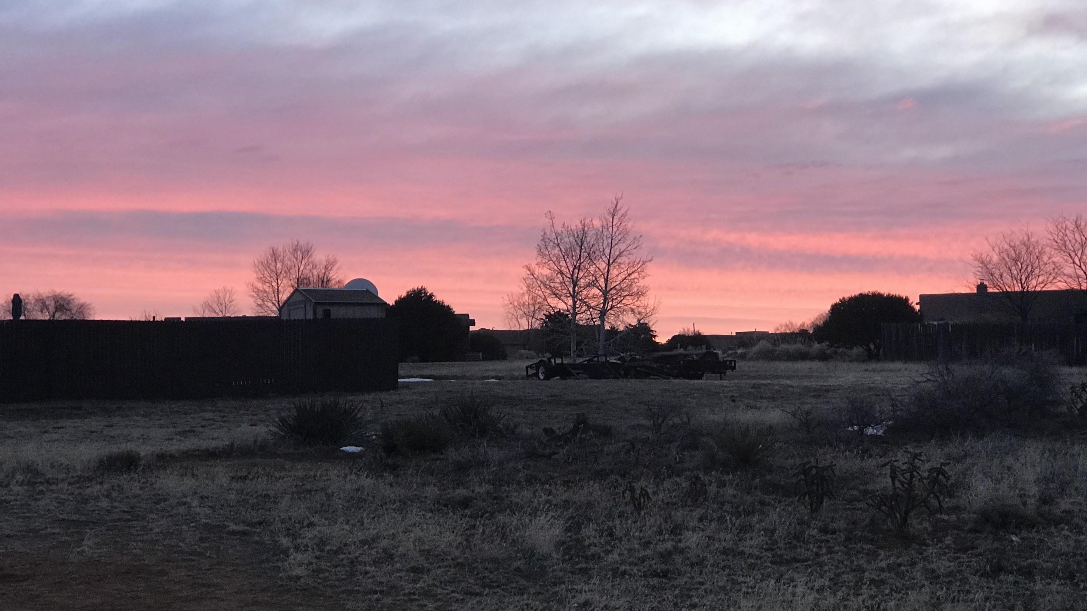
We are seeking to minister to the needs of men and boys on a personal and human level.
We continue to learn from each group.
“The deepest hunger of [a child's] human heart is to be understood, for understanding implicitly affirms, validates, recognizes and appreciates the intrinsic worth of another”
Stephen Covey

