Slide 1

An Ontogenic Process Perspective on Adjustment Problems Across the Lifespan:
Neurobiological Vulnerabilities, Environmental Risk Factors, and Differential Outcomes for Boys Versus Girls
Theodore P. Beauchaine

Slide 2
Objectives
Describe developmental trajectories of impulsive behavior from preschool to adulthood—at all relevant levels of analysis—for those reared in high risk environments
Present new data on impulsive girls, who are understudied to date
Embrace etiological complexity—no single level of analysis (genes, neural functions, maltreatment, neighborhood risk) accounts for progression of impulsivity to more
severe endpoints
Consider complex interactions and transactions between and among endogenous vulnerabilities and exogenous risk factors across development:
    multifactorial molecular genetic burden
    behavioral genetic, neural, and environmental factors/influences
    differential neuromaturation of cortical vs. subcortical neural networks
    cortical-subcortical connectivity
    environmentally induced neuroplastic changes in cortical structure and function
Notes:
This isn’t a big deal but the formatting here differs from your first “Objectives” slide in that you present all the points here but not in the first slide.

Slide 3
Life-course Persistent Externalizing Behavior
ADHD
ODD
Early-onset CD
SUDs
ASPD
school conduct
problems, suspensions
academic problems
drug use,
criminality
hyperactivity-
impulsivity
oppositionality
& aggression
disengagement
& withdrawal
delinquent
peer groups
incarceration,
recidivism
age
preschool
middle-school
adolescence
adulthood
e.g., Beauchaine & McNulty, 2013; Lahey et al., 2016; Moffitt, 1993; Robins, 1966
Notes:
Do you tie in the “high-risk environments” somewhere and I am missing it from the slides?
I’m referring to your point on the objectives slide “Describe developmental trajectories of impulsive behavior from preschool to adulthood—at all relevant levels of analysis—for those reared in high risk environments”

Slide 4
Objectives
Describe developmental trajectories of impulsive behavior from preschool to adulthood—at all relevant levels of analysis— for those reared in high risk environments
Present new data on impulsive girls, who are understudied to date
Embrace etiological complexity—no single level of analysis (genes, maltreatment, neighborhood risk) accounts for progression of impulsivity to more severe endpoints
Consider complex interactions and transactions among child vulnerabilities and environmental risk factors across development:
    complex molecular genetic burden
    complex neural functions
    differential neuromaturation of cortical vs. subcortical neural networks
    cortical-subcortical connectivity
    environmentally induced (neuroplastic) changes in cortical structure and function
Notes:
This isn’t a big deal but the formatting here differs from your first “Objectives” slide in that you present all the points here but not in the first slide.

Slide 5
Ontogenesis of Type II Diabetes
multifactorial genetic
burden
latent
vulnerability
heritable
trait
(h² .̃8)
Level of Analysis
insulin
resistance
syndrome
(phenotype)
pancreatic beta cell
death
weight gain, metabolic syndrome
heart disease, renal failure
peripheral neuropathy,
amputation
fat and
sugar intake
lack of exercise
stress
poor
self-care
environmental
risk mediator
time
LaSalle et al., 2005
Notes:
At least 36 genes implicated.
Highly heritable diseases progress (or arrest) via transactions with environments. Type II diabetes more heritable than type I!
Even though we may diagnose kidney failure, we do not attribute to a causally independent disease state because etiology is known.
Is “trait” the right word for the latent vulnerability you reference?

Slide 6
Ontogenesis of Externalizing Behavior
molecular genetic
burden
heritable trait
impulsivity
(h² .̃8)
behavioral genetic (latent)
vulnerability
Level of Analysis
ADHD
(HI/combined)
syndrome
(phenotype)
oppositional defiant
disorder
conduct disorder/
delinquency
ASPD, incarceration, recidivism
substance use, dependence
coercive family processes
deviant peer group affiliations
availability, opportunity, exposure
neighborhood violence, criminality
environmental
risk mediator
e.g., Patterson et al., 2000
e.g., Dishion et al., 1999
e.g., Sibley et al., 2014
e.g., Meier et al., 2008
preschool elementary school middle school adolescence adulthood
Beauchaine, Hinshaw, & Pang, 2010; Beauchaine, Shader, & Hinshaw, 2017; Beauchaine et al., 2017; Moffitt, 1993; Robins, 1966
Notes:
At least 36 genes implicated.
Highly heritable diseases progress (or arrest) via transactions with environments. Type II diabetes more heritable than type I!
This
These are really cool slides! What would you think about trying to show that these early environments are still likely relevant even as kids grow older (e.g., coercive family processes don’t “go away”).

Slide 7
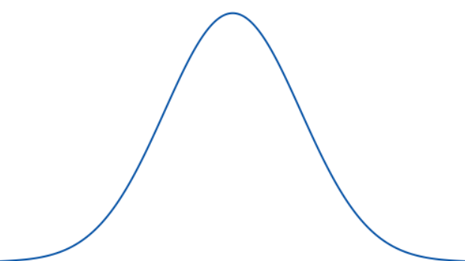
Trait Impulsivity as a Behavioral Construct
Trait impulsivity is an individual difference. When extreme, it is characterized by:
  preference for immediate rewards over delayed rewards
  actions taken without forethought
  failures to plan ahead
  deficiencies in self-control
As an individual difference, trait impulsivity is:
  a normally distributed personality trait
  highly heritable (h² ̃.8)
  stable across development
  rooted in well characterized brain processes that often become ‘canalized’ across development in response to environmental risk
restrained average highly impulsive
unimpulsive exuberant (ADHD)
Beauchaine et al., 2017; Barkley, 2004; Sagvolden et al., 2005
Notes:
Although I prefer a neural systems first approach rather than a behavior first approach, it is useful for this presentation to define impulsivity before proceeding
I edited your first line and second bullet point (it sounded like you were saying when extreme it is normally distributed.
Acting wo forethought and failure to plan seem quite similar.
Part of the canalization is niche-fitting etc no? Maybe that is your last point.

Slide 8
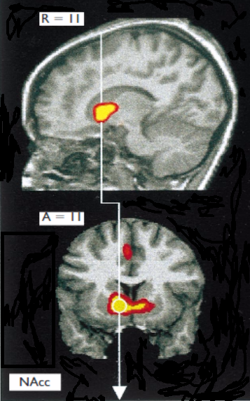
Subcortical Substrates of Impulsivity I
  Approach-related emotions (wanting, seeking, enthusiasm) are generated in large part by striatal reactivity (ventral and dorsal) to anticipated incentives (Panksepp, 2016; Sagvolden et al., 2005)
Knutson et al., 2001
Notes:
Reading this it’s hard to tell how you connect this to the last slide but maybe that’s just because I am not hearing the talk.

Slide 9
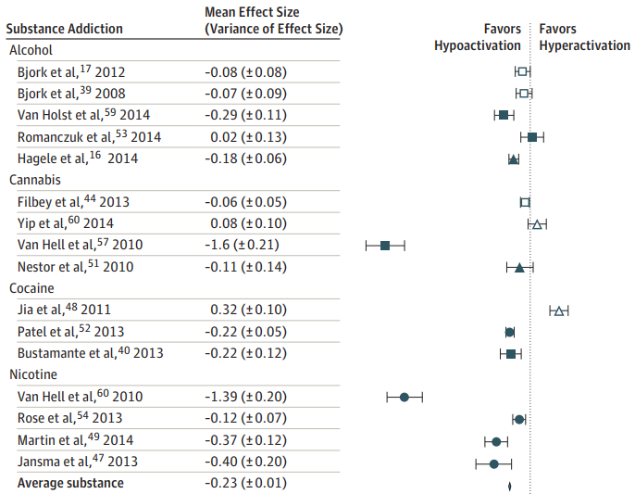
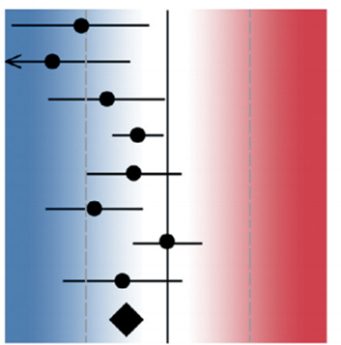
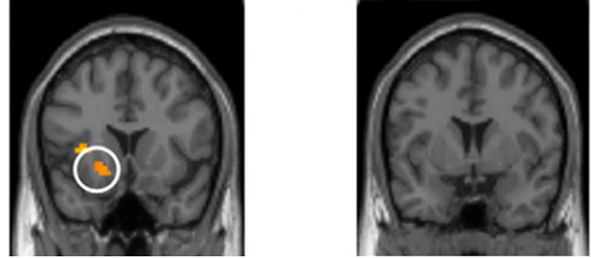

Subcortical Substrates of Impulsivity II
  Striatal activity and reactivity to appetitive stimuli are associated with positive hedonic capacity and states (e.g., Berridge & Kringelbach, 2015)
  Striatal under-activity is associated with anhedonia, trait irritability, and discontentment—
  hallmarks of externalizing disorders (Laakso et al., 2003, Zisner & Beauchaine, 2016)
  Striatal hypo-responding to incentives is widely replicated in ADHD and other externalizing syndromes (CD, ASPD, SUDs) (Alegria et al., 2016; Laine et al., 2001; Oberlin et al., 2012; Plichta & Scheres, 2014; Rubia et al., 2009; Volkow et al., 2004)
According to reward-seeking models, discontentment and irritability motivate reward-
seeking behavior (e.g., impulsivity, substance use), which upregulates aversive mood
Mood elevation is transient, so affected individuals continually seek external reinforcers
ADDICTION
ADHD
hypoactivation hyperactivation
control
ADHD
striatal responding to incentives
striatal responding to incentives
Luijten et al., 2017; Plichta & Scheres, 2014; Scheres et al., 2007; Ströhle et al., 2008; Wenjing et al., 2014

Slide 10
Complexity of Striatal Function
neuro-hormonal
modulators
estradiol, progesterone levels
HPA axis function
testosterone
levels
environmental influences
TBI, hypoxia,
teratogen
exposure
blunted
striatal
responding
emotional
predisposition
anhedonic,
irritable mood
state
behavioral
bias
reward-
seeking
trait impulsivity/
ADHD
epigenetic
regulation of
receptor
function
DAT, DRD
SLC6A4
CACNA1C
disrupted
neuro-
development
vulnerability
alleles
18p11.32
16p11.2
CNV burden
genetic
liability/burden
de novo
mutations
heritable
CNVs
emotional
neurobiological
normative- behavioral
syndromal
LEVEL OF ANALYSIS
Beauchaine & Constantino, 2017; Gatzke-Kopp, 2011, Gizer & Ellingson, 2017
Notes:
CACNA1C gene (calcium voltage-gated channel subunit alpha1 C)
Tory Eisenlohr-Moul

Slide 11
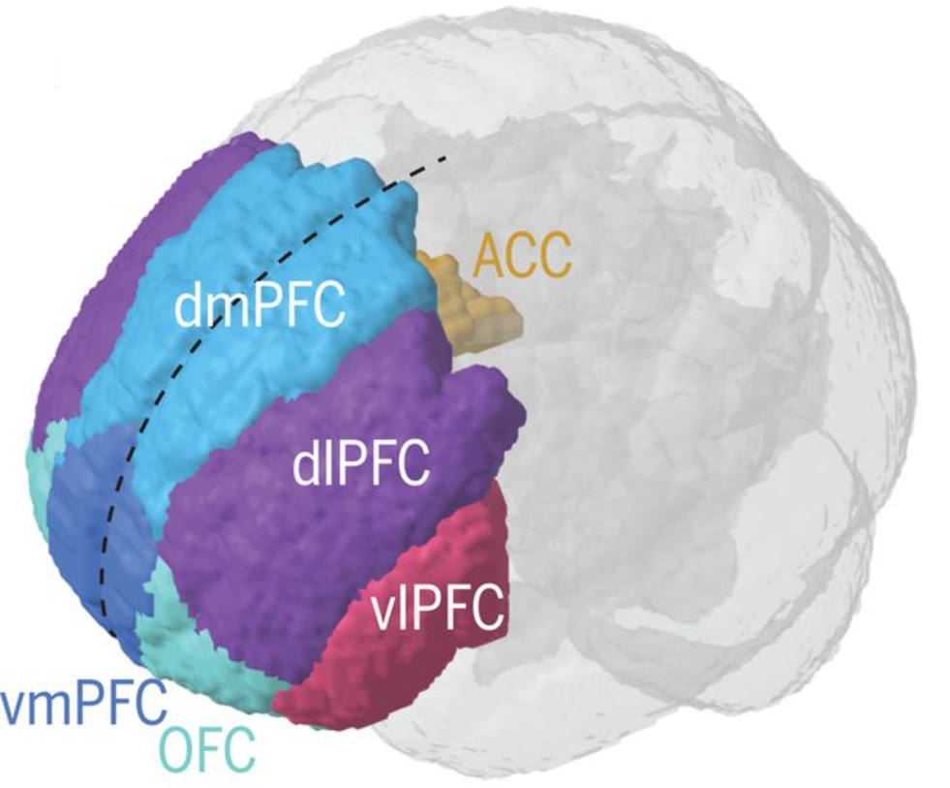
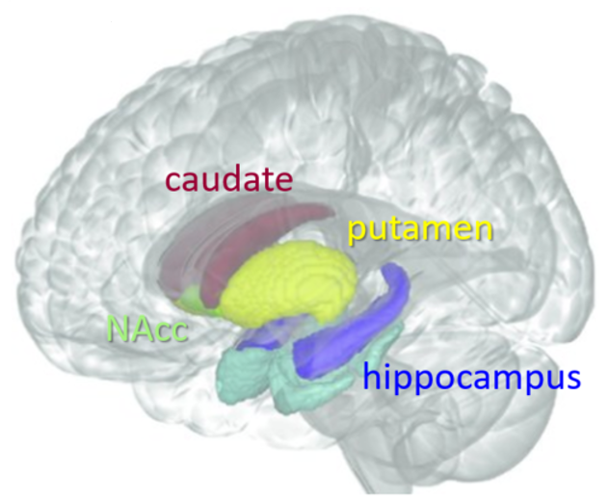
Cortical Contributions
cortex:
behavior and
emotion regulation
subcortex:
motivation and
emotion generation
e.g., Beauchaine, 2015; Heller…Casey; 2016; Nelson et al., 2014; NIMH, 2017; Wenjing et al., 2014
Notes:
Here is a lateral view of the cortex. A medial view would show the ACC and vmPFC as well.

Slide 12

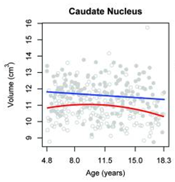
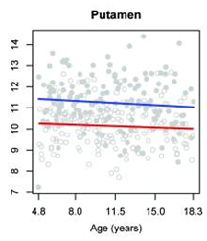
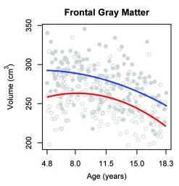
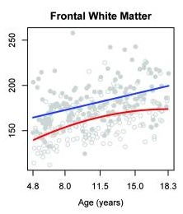
Cortical vs. Subcortical Neuromaturation
subcortex
(emotion generation)
cortex
(emotion regulation)
Brain Development Cooperative Group, 2012
Notes:
Normally, self-regulation improves across childhood and adolescence as PFC neuromaturation ‘catches up’ with subcortical neuromaturation (Casey et al., 2008)

Slide 13
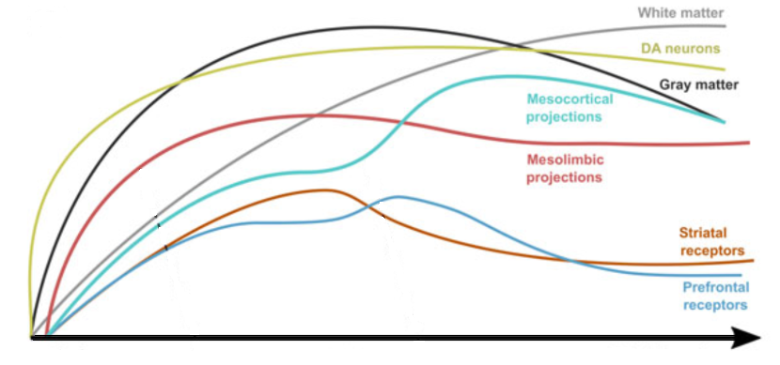
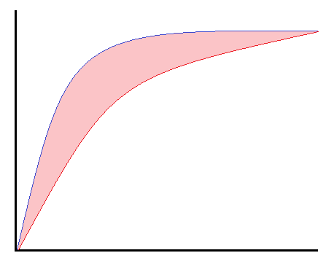
Neuromaturation: Subcortex vs. PFC
Differential neuromaturation is one explanation for engagement
in normative risky behaviors in adolescence:
subcortex
(emotion generation)
RISKY PERIOD
cortex
(emotion regulation)
neuroanatomical, functional maturation
birth childhood adolescence adulthood
childhood adolescence early adulthood
Casey et al., 2008; Hauser et al. 2019

Slide 14
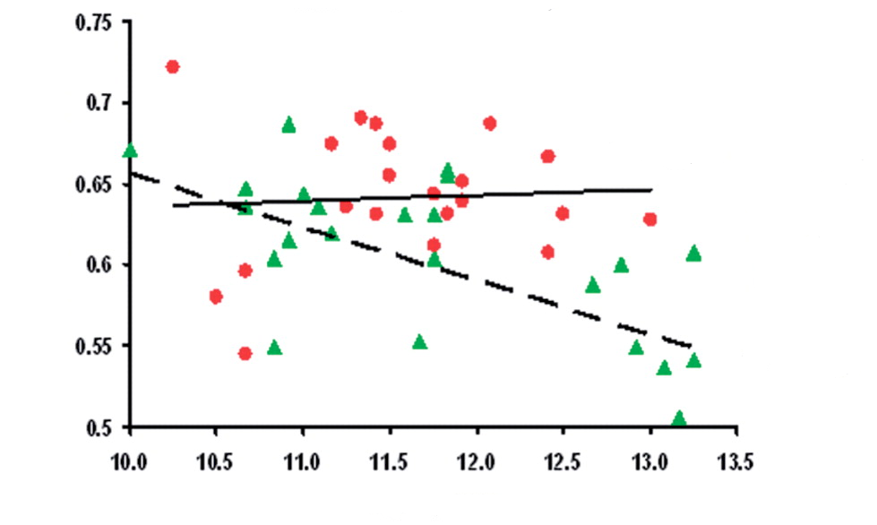
Delayed Neuromaturation in Conduct Disorder
Among males who progress to conduct disorder, frontal neuromaturation
is compromised:
externalizing
OFC/ACC gray matter volume
control
Age
De Brito et al., 2009

Slide 15
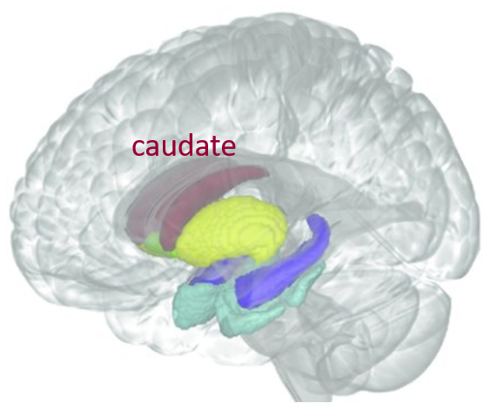
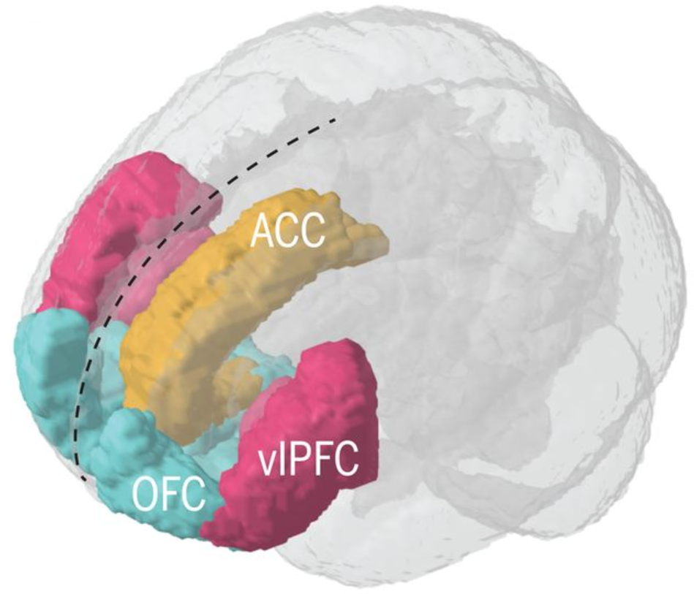
Subcortical-Cortical Connectivity
control
-.12*
-.38**
-.17*
-.02
ADHD/CD
Shannon, Sauder, Beauchaine et al., 2009
Notes:
Normally, self-regulation improves across childhood and adolescence as PFC neuromaturation ‘catches up’ with subcortical neuromaturation (Casey et al., 2008)

Slide 16
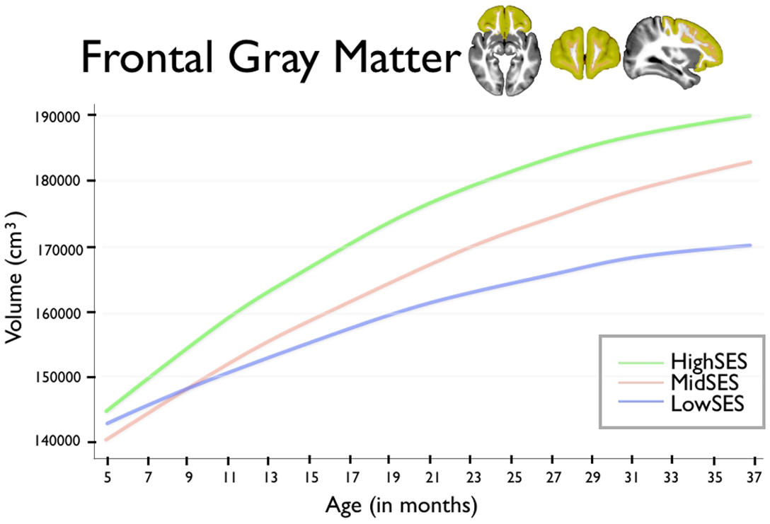
Adversity and PFC Neuromaturation
    Environmental adversities affect PFC neuromaturation strongly (e.g., Luby, 2015):
        poverty—children who live below FPL show a 7-10% reduction in frontal volumes
        compared with controls (Hair, NIH Study of Normal Brain Development, 2015; Hanson et al., 2010)
        child abuse/neglect—which is common in externalizing samples—is associated
        with dose-response reductions in OFC volumes (Hanson et al., 2013)
        institutionalization—children reared in Romanian orphanages exhibit smaller
        cortical volumes than controls (Sheridan et al., 2012)
Notes:
Family stress examples include low emotional support, coercion, arguments
JAMA Pediatrics
Sarah E. Romens, Jennifer McDonald, John Svaren, and Seth D. Pollak. University of Wisconsin–Madison. Epigenetic changes in the glucocorticoid receptor gene, a critical component of stress regulation, were examined in whole blood from 56 children aged 11–14 years. Children exposed to physical maltreatment had greater methylation within exon 1F in the NR3C1 promoter region of the gene compared to nonmaltreated children, including the putative NGFI-A (nerve growth factor) binding site.

Slide 17
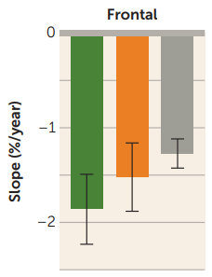
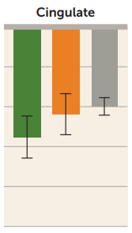
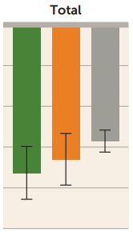
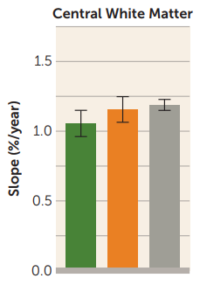

Neural Predictors & Sequelae of Substance Use
Blunted striatal responses to reward are associated with vulnerability to marijuana, cocaine, methamphetamine abuse and addiction three years later
Heavy drinking in adolescence is associated with faster gray matter loss and slower white matter growth in the cortex over two years:
Poorer subcortical-cortical connectivity is also observed
Bottom line:
By the time many impulsive children reach adolescence, their existing subcortical vulnerabilities are amplified by environmental adversities and risk exposures, which alter neurodevelopment of cortical brain regions critical to self- and emotion regulation
gray matter change
Blair et al., 2018; Nguyen-Louie et al., 2018; Pfefferbaum et al., 2018

Slide 18
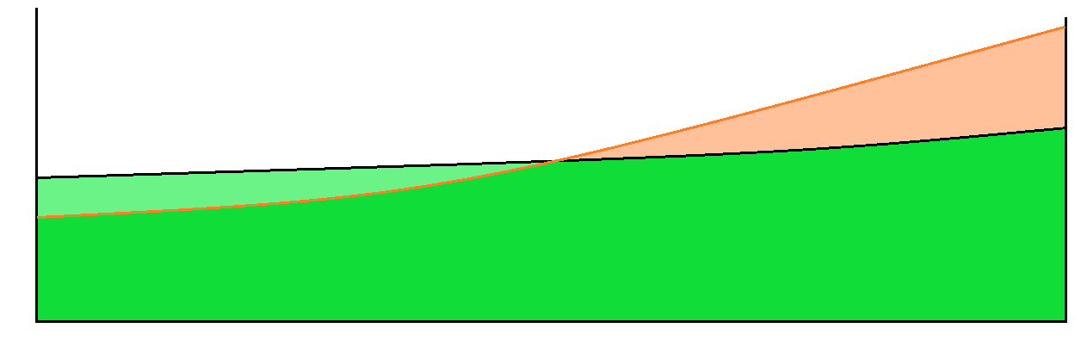
An Elaborated Neurodevelopmental Model
trait impulsivity
(reward-seeking)
subcortical,
highly heritable
self-, emotion
dysregulation
cortical ↔ subcortical
highly socialized
temperamental/
behavioral bias
ADHD
(HI/combined)
Level of Analysis
oppositional defiant
disorder
conduct
problems
ASPD, incarceration, recidivism
behavioral
syndrome
delinquency
substance use, dependence
availability, opportunity, exposure
coercive
family
processes
deviant
peer group affiliations
neighborhood violence, criminality
criminal
justice involvement
environmental
risk mediator
preschool elementary school middle school adolescence adulthood
Self & Emotion Dysregulation
cortical dysfunction, poor
cortical-subcortical connectivity
Degree of Impairment
TRAIT IMPULSIVITY
subcortical dysfunction
Beauchaine, Constantino, & Hayden, 2018; Beauchaine, in press

Slide 19
Implications for Prevention: The NIMH Fast Track Trial
891 high risk kindergarteners enrolled (Seattle, Durham, Nashville, rural PA)
Selected from almost 10,000 based on parent, teacher reports of early CPs
Intensive, 10-year-long prevention program that began in 1991:
Limited effects of intervention in early years (e.g., McMahon et al., 1999)
Effects accrued through age 25:
  ↓ externalizing problems ↓ internalizing problems
  ↓ substance use ↓ high-risk sexual behavior
  ↓ violent crime convictions ↓ drug convictions
This contrasts with long-term outcomes from the NIMH Multimodal Treatment of ADHD study, which were time-limited (Hinshaw et al., 2015; Molina et al., 2013)
Prevention programs that target mediating mechanisms of externalizing progression are effective when delivered early, when they involve parents, and when they teach children effective self-regulation
  Grade 1: 57 two-hr sessions with children, parents, program staff, and teachers
  targets: self-control, emotional awareness, peer relations, problem solving
  Grade 1: Parents taught to tutor their children academically
  Grades 3, 4: Monthly family sessions, home visits; teacher-implemented prevention
  Grades 5, 6: Monthly parent and child groups and home visits
  Grades 8-10: Individual sessions addressing HS transition, note-taking, study skills, etc.
Conduct Problems Prevention Research Group, 2002, 2015

Slide 20
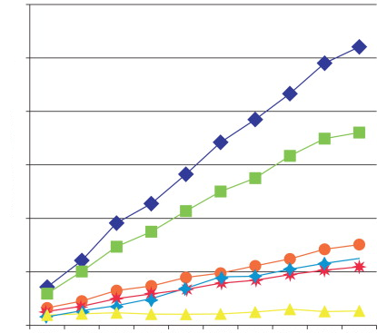

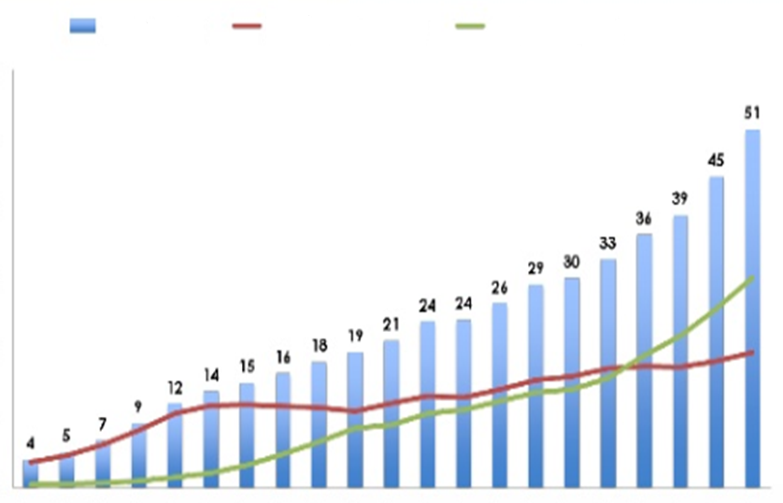

U.S. Stimulant Prescriptions, 1991-2011
Atypical Antipsychotic Prescriptions, 1999-2008
US Healthcare Ignores Development, Context
more meds
meds,
juvenile justice
ADHD
CD
schizophrenia
mood disorders
ASD
tics
different meds
meds,
incarcerate
incarcerate
all methylphenidate amphetamine
meds
ADHD
ODD
DMDD
Early-onset CD
SUDs
ASPD
school conduct
problems, suspensions
academic problems
drug use,
criminality
prescriptions per 1000 (ages 7-18)
0 1 2 3 4 5 6
hyperactivity-
impulsivity
millions
0 10 20 30 40 50 60
oppositionality
& aggression
disengagement
& withdrawal
delinquent
peer group
incarceration,
recidivism
1. risperidone
2. quetiapine
3. olanzapine
age
preschool
middle-school
adolescence
adulthood
1991 1996 2001 2006 2011
99 00 01 02 03 04 05 06 07 08
National Institute on Drug Abuse
Alessi-Severini et al., 2012, Olfson et al., 2015
Notes:
Some the slides have text that covers other text but I’ll assume things look fine on your computer.

Slide 21
What About Girls?
developmental pathways of impulsivity not well characterized for girls
in 2009, our group published two review papers:
  similar family interaction patterns for delinquent boys, self-injuring girls (Crowell et al., 2013, 2017)
  overlapping molecular genetic risk for ADHD in boys, self-injury in girls (Beauchaine et al., 2009)
  self-injury marks prospective risk for BPD (Linehan, 1993; Crowell, Beauchaine, & Linehan, 2009)
  women who develop BPD are often reared in families with an antisocial brother (Goldman et al., 1993)
  strong sex biases in BPD and ASPD diagnoses (e.g., Becker & Lamb, 1994)
hypothesis: impulsive girls with ADHD should be vulnerable to self-injury and BPD development specifically in high risk environments
insufficient data available in 2009; this has since changed

Slide 22
ADHD, Maltreatment, and Self-Harm for Girls
Berkeley Girls with ADHD Longitudinal Study (BGALS, Hinshaw)
  140 girls, ages 6-12, with ADHD (93 combined, 47 inattentive)
  followed up in late teens/early adulthood
Girls with ADHD (HI, combined) who also incur physical and/or sexual abuse exhibit alarming rates of self-injury, suicide attempts
Guendelman et al., 2016; Owens & Hinshaw, 2016

Slide 23
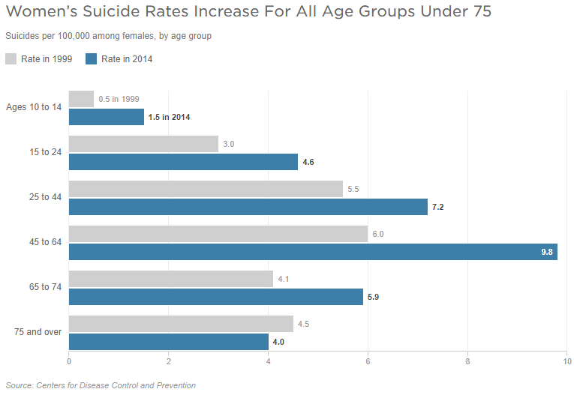
Women’s Suicide Rates 1999-2014
300%
increase
53%
increase
31%
increase
63%
increase
44%
increase
Ammerman et al., 2017; CDC, 2006, 2014, 2017; Nock, 2009
Notes:
1. Nock, 2009; 2. CDC, 2006; 3. Berman et al., 2006; 4. CDC, 2014; 5. Ammerman et al., 2017

Slide 24
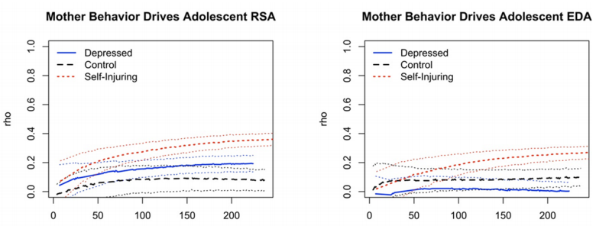
Self-harming, ADHD Girls’ Family Interactions
Patterns of autonomic reactivity to maternal aversive behaviors among self-injuring (n=26) depressed (n=24) and control (n=24) girls
Although recruited solely for self-harm, the self-injury group scored in the clinical range on ADHD (T > 70)
Dyadic conflict discussion task designed to evoke disagreement
Nonlinear dynamic modeling used to evaluate adolescent girls’ vagal and electrodermal reactivity to mothers’ aversive behaviors
Extends previous work with ADHD boys to self-injuring girls
seconds of conflict task seconds of conflict task
Crowell, …Beauchaine, 2017

Slide 25
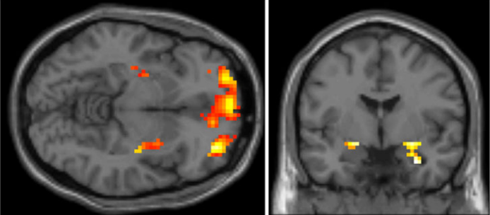
Self-harming Girls’ Neural Responding to Reward
Patterns of subcortical (striatal, amygdalar) and cortical (OFC) responding to incentives for self-injuring (n=19) and control (n=19) adolescent girls
Although again recruited solely for self-harm, ADHD symptoms elevated (d=0.90)
As in studies of ADHD boys, we used Knutson’s MID task
Like boys with ADHD, girls recruited for self-harm show blunted responding to incentives in both striatal and orbitofrontal regions
striatal, orbitofrontal, and amygdalar ROIs in which
self-injuring girls exhibit less activation to reward cues
Sauder, Derbidge, & Beauchaine, 2016

Slide 26
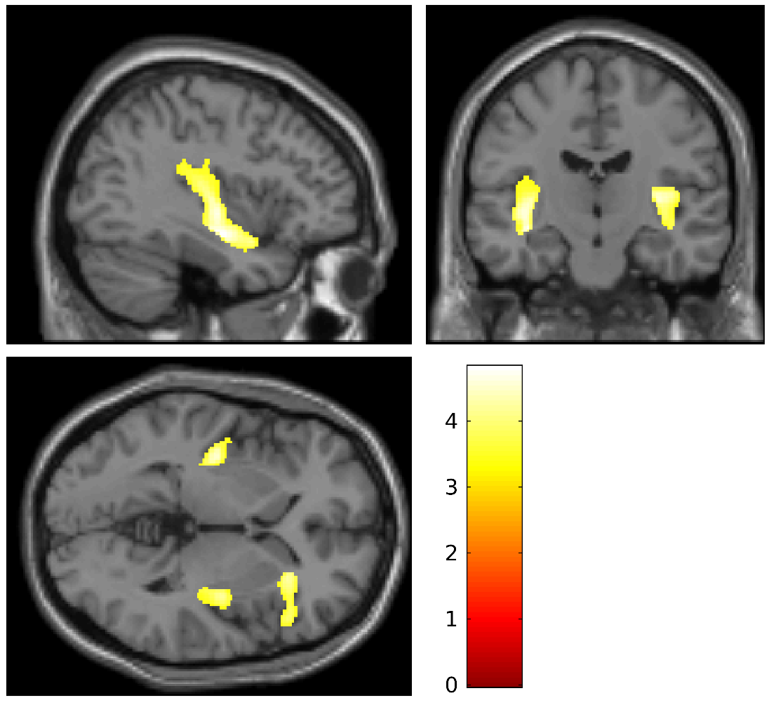
Cortical Structure and Self-harm Among Girls
Same sample of self-injuring (n=19) and control (n=19) adolescent girls
Smaller bilateral insula and right inferior frontal gyrus volumes for self-injurers
These brain regions serve core self- and emotion regulation functions
(e.g., Grecucci et al., 2013; Zilverstand et al., 2013)
Findings parallel those from externalizing males, adult women with BPD, and adolescents on first presentation of BPD (e.g., Fairchild et al., 2011, 2013; Soloff et al., 2008; Takahashi et al., 2009)
Beauchaine et al., 2019

Slide 27
Summary: Self-injuring Girls
Like boys with ADHD, girls with ADHD are vulnerable to developing more severe psychopathology in high risk environments
However, behavioral trajectories are moderated by sex
  boys more vulnerable to delinquency
  girls more vulnerable to self-injury
  importantly, these are not exclusive outcomes
Self-injuring girls with ADHD experience similar family dynamics as externalizing boys
Self-injuring girls exhibit similar neural responses to incentives as externalizing boys
We can now speculate about pathways from early impulsivity to later self-harm (and BPD development) for girls (e.g., Crowell, Linehan, & Beauchaine, 2009; Derbidge & Beauchaine,. 2014)
Notes:
Is it basically like Moffitt’s model in that the early vulnerabilities/risks are the same for boys and girls, it’s just that boys have more of them?

Slide 28
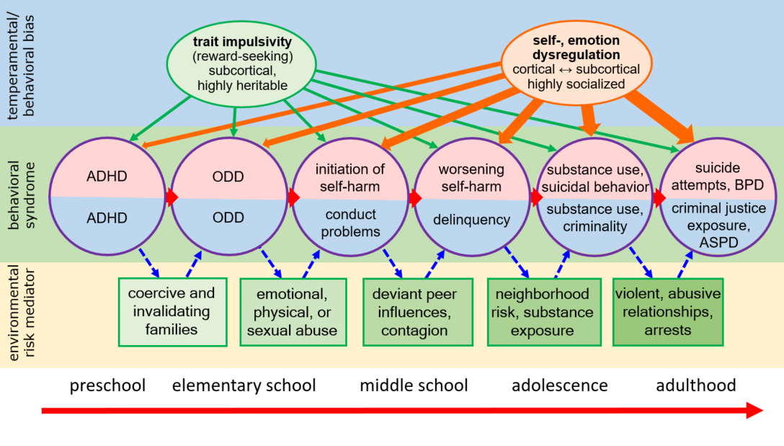
A Unified Developmental Model
Beauchaine, in press

Slide 29
































Acknowledgements
Stephen Hinshaw
Lisa Gatzke-Kopp
Sheila Crowell
Carolyn Webster-Stratton
Jamila Reid
Itzhak Ben-David
Marieke Bos
Emily Neuhaus
Jiancheng Hou
Penny Marsh
Patricia Pittman
James Hong
Kate Shannon
Colin Sauder
Sharon Brenner
Adrianne Stevens
Hilary Mead
Nate Haines
Karen Pang
Heather
McDonough-Caplan
Ziv Bell
Dana Kamara
Tiffany Shader
Aimee Zisner
Hunter Hahn
Christina Derbidge
Notes:
Child trauma questionnaire, brief child abuse potential inventory
If you have trainees to acknowledge I would do so. Makes a good impression re mentoring/training.

Slide 30
Questions?
Notes:
Child trauma questionnaire, brief child abuse potential inventory
If you have trainees to acknowledge I would do so. Makes a good impression re mentoring/training.

Slide 31
Recent Findings
Few longitudinal studies of impulsivity for boys or girls assess real-world adolescent or adult adjustment
Treatment studies focus primarily on syndromal outcomes (e.g., hyperactivity, oppositionality)
Newer, naturalistic follow-ups show minimal effects of evidenced-based childhood treatment on adult functional outcomes
(e.g., Hinshaw et al., 2015; Hechtman et al., 2016; Owens et al., 2009)
Longitudinal study of social dynamics in high risk families of girls
and boys with ADHD—including opposite-sex siblings
  ∙ educational attainment ∙ employment transitions, terminations
  ∙ income ∙ public assistance
  ∙ high risk sexual behavior ∙ alcohol use disorder
  ∙ jail time ∙ premature death
  ∙ social skills
Notes:
I can’t tell how the second point feeds into the future directions.

Slide 32
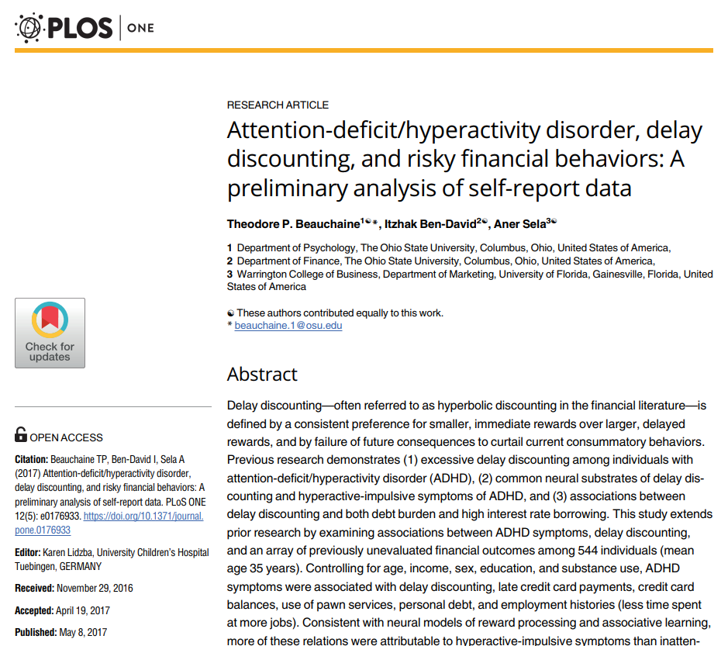
Adult Functional Outcomes of Impulsivity
Impulsivity, financial distress, and suicide in the Swedish population
(Beauchaine Ben-David, & Bos, 2019)
ICD diagnostic codes obtained from 2002-15 for all Swedish adults (N=11,549,184), including n=176,350 ever diagnosed with ADHD
Objective credit data (e.g., requests, arrears, credit scores) obtained from
the Swedish Credit Bureau
Objective: replicate and extend previous self-report findings regarding financial distress and poor credit among adults with ADHD
The very large sample afforded many other opportunities:
  associations between ADHD and financial outcomes by age
  associations between ADHD, sympathomimetic prescriptions and finances
  associations between financial outcomes and suicide by age
Longitudinal study of social dynamics in high risk families of girls
and boys with ADHD—including opposite-sex siblings
Notes:
Lifetime prevalence .015
.044 in US: Kessler RC et al. (2006). The prevalence and correlates of adult ADHD in the United States: Results from the National Comorbidity Survey Replication. Am J Psychiatr 163:716-723.

Slide 33
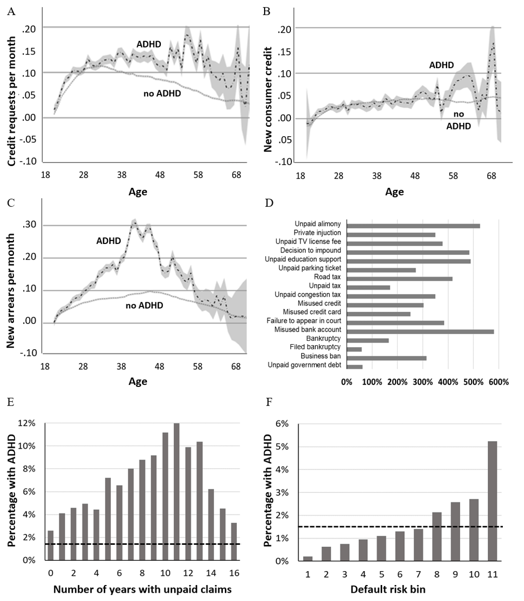
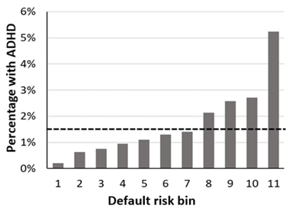
ADHD and Financial Outcomes by Age
Notes:
Credit request values are residualized, adjusting for education, income, and sex, and can therefore extend below zero

Slide 34
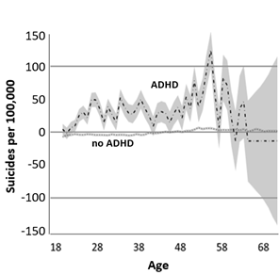
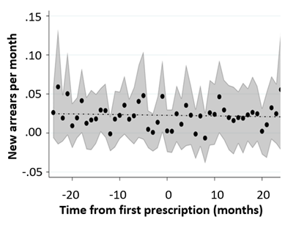
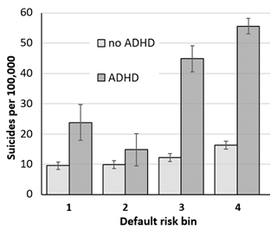
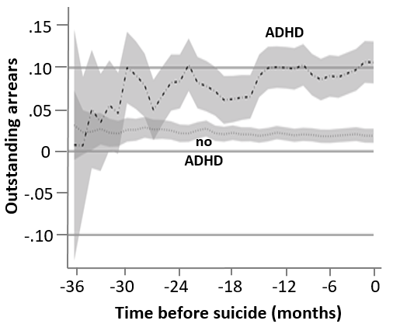
ADHD, Financial Outcomes, and Suicide
Notes:
sympathomimetic prescriptions for ADHD (e.g., methylphenidate, atomoxetine, amphetamine, dextroamphetamine)
Credit request values are residualized, adjusting for education, income, and sex, and can therefire extend below zero

Slide 35
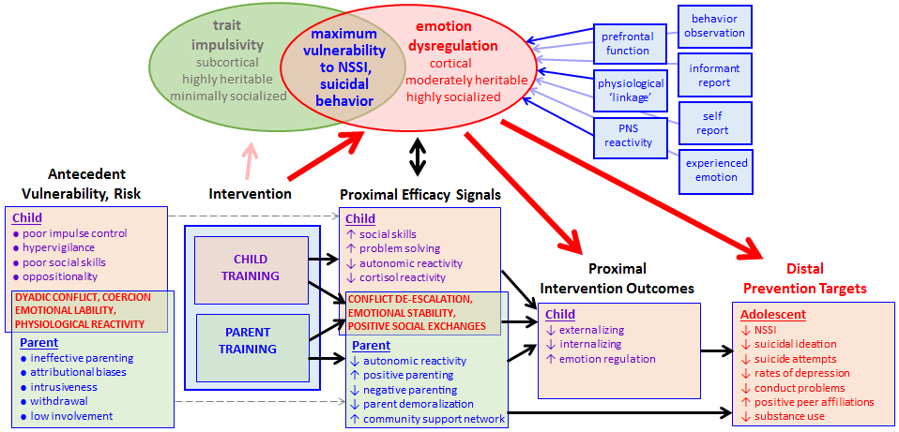
Implications for Suicide Prevention
Highly impulsive young girls with who also incur maltreatment are at 50% risk for developing NSSI, and at 33% risk for eventual suicide attempts (Beauchaine et al., 2019)
Many girls now initiate NSSI before age 10 (Ammerman et al., 2017)
These early-starters exhibit greater frequency of NSSI, use more diverse methods, and are hospitalized more often
When delivered in adolescence, the best interventions are 50% effective in reducing NSSI, suicidal behaviors

Slide 36
U.S. Stimulant Prescriptions, 1991-2011
Atypical Antipsychotic Prescriptions, 1999-2008
US Healthcare Ignores Development, Context
more meds
meds,
juvenile justice
ADHD
CD
schizophrenia
mood disorders
ASD
tics
different meds
meds,
incarcerate
incarcerate
all methylphenidate amphetamine
meds
ADHD
ODD
DMDD
Early-onset CD
SUDs
ASPD
school conduct
problems, suspensions
academic problems
drug use,
criminality
prescriptions per 1000 (ages 7-18)
0 1 2 3 4 5 6
hyperactivity-
impulsivity
millions
0 10 20 30 40 50 60
oppositionality
& aggression
disengagement
& withdrawal
delinquent
peer group
incarceration,
recidivism
1. risperidone
2. quetiapine
3. olanzapine
age
preschool
middle-school
adolescence
adulthood
1991 1996 2001 2006 2011
99 00 01 02 03 04 05 06 07 08
National Institute on Drug Abuse
Alessi-Severini et al., 2012, Olfson et al., 2015
Notes:
Some the slides have text that covers other text but I’ll assume things look fine on your computer.

Slide 37
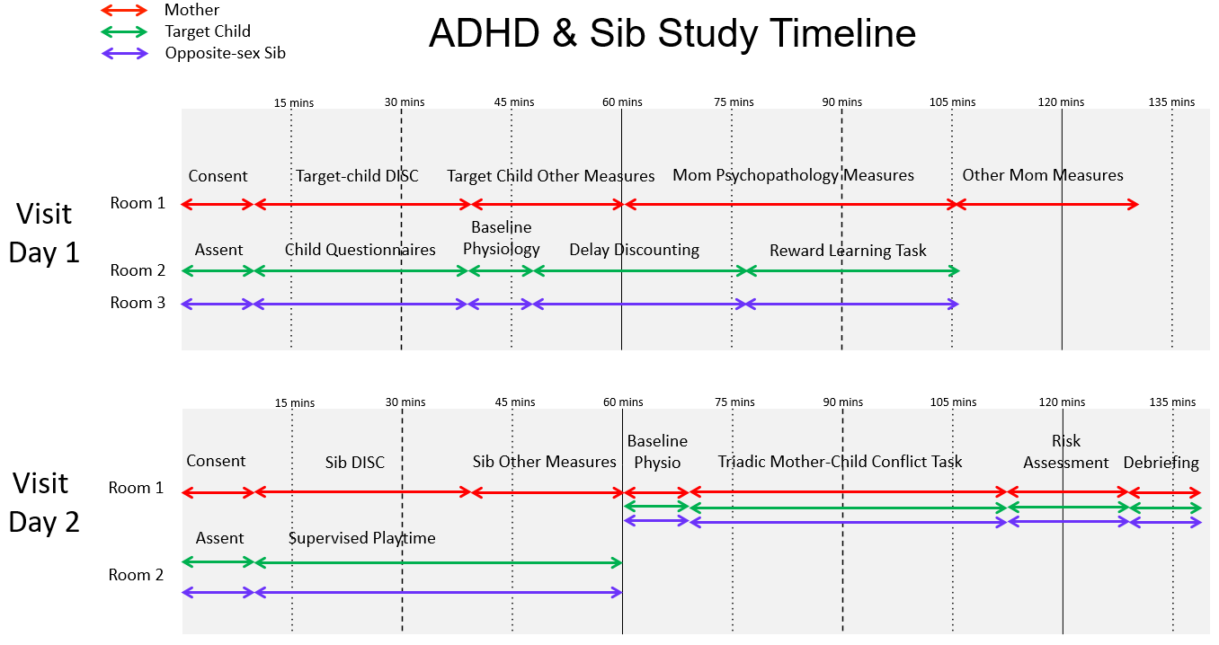
ADHD-Sib Pair Study

Slide 38
Mediators of Progression to NSSI, SBs
Externalizing Psychopathology
Adolescent/
young adult
NSSI
Childhood
ADHD
(HI/Combined)
Internalizing psychopathologY
Adolescent/
young adult
Suicide Attempts
Peer
REJECTION,
Victimization
traditional thinking about
vulnerability to NSSI, SBs
ages 6-12 ages 11-18 ages 17-24
Beauchaine et al., 2019; Meza et al., 2016; Owens & Hinshaw, 2016; Swanson et al., 2014

